Slide 1
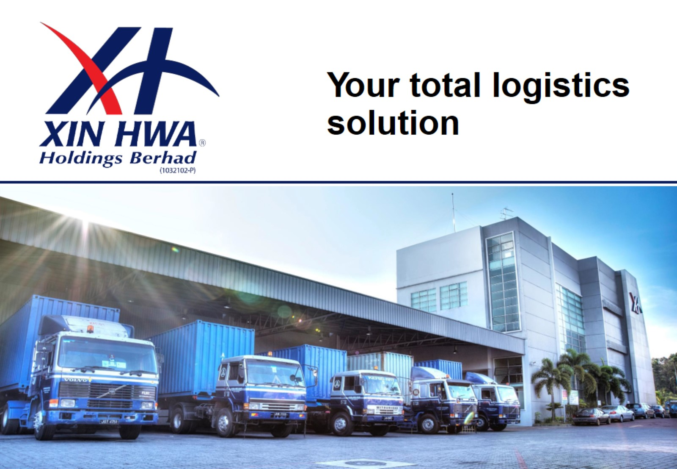

Slide 2
Corporate & Shareholding Structure

Slide 3
Our Principal Business Activities

Slide 4
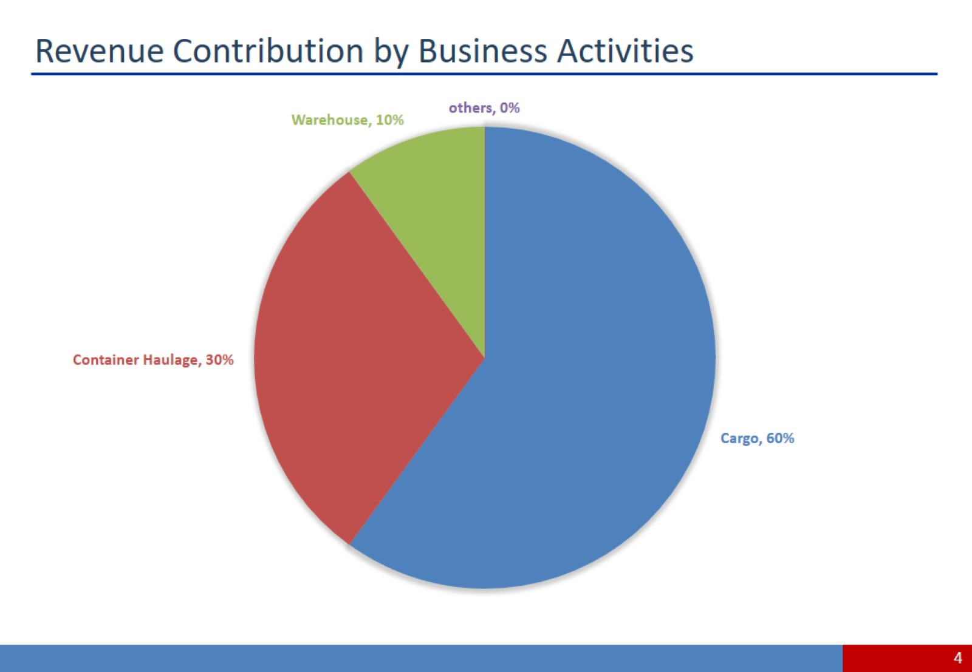
Revenue Contribution by Business Activities

Slide 5
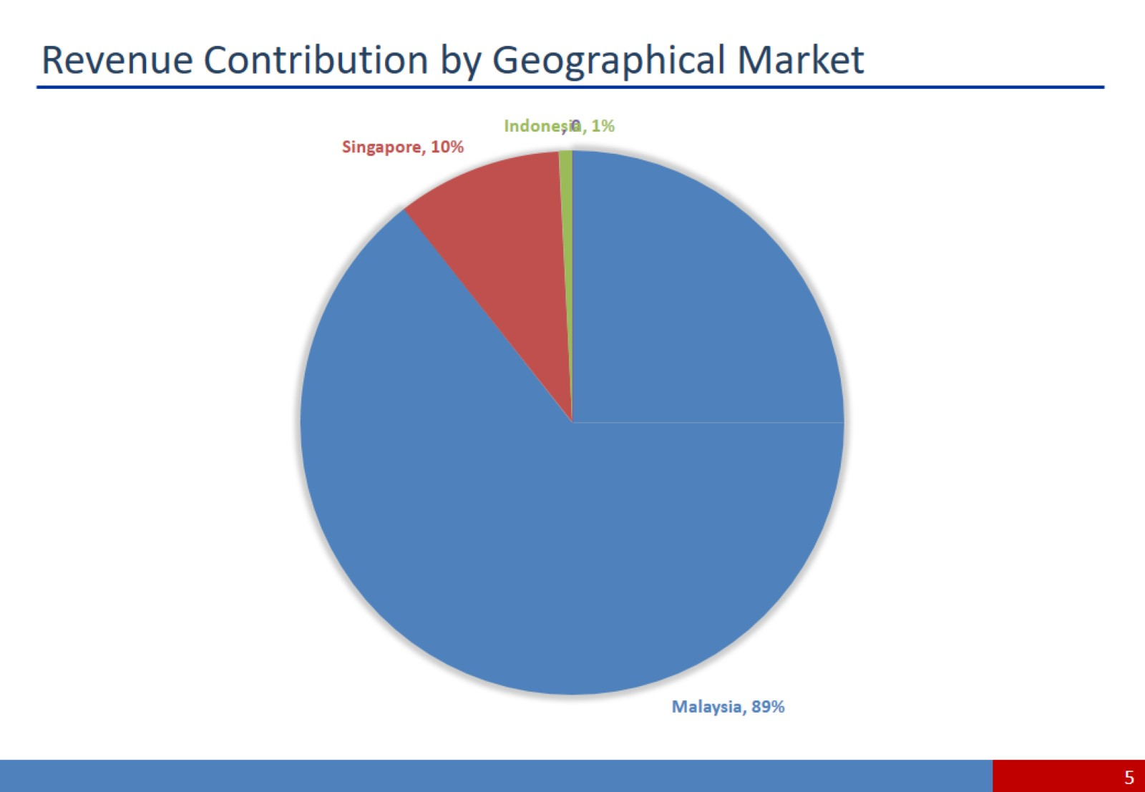
Revenue Contribution by Geographical Market

Slide 6
Our Principal Business Activities

Slide 7
Land Transport – Cargo Transportation

Slide 8
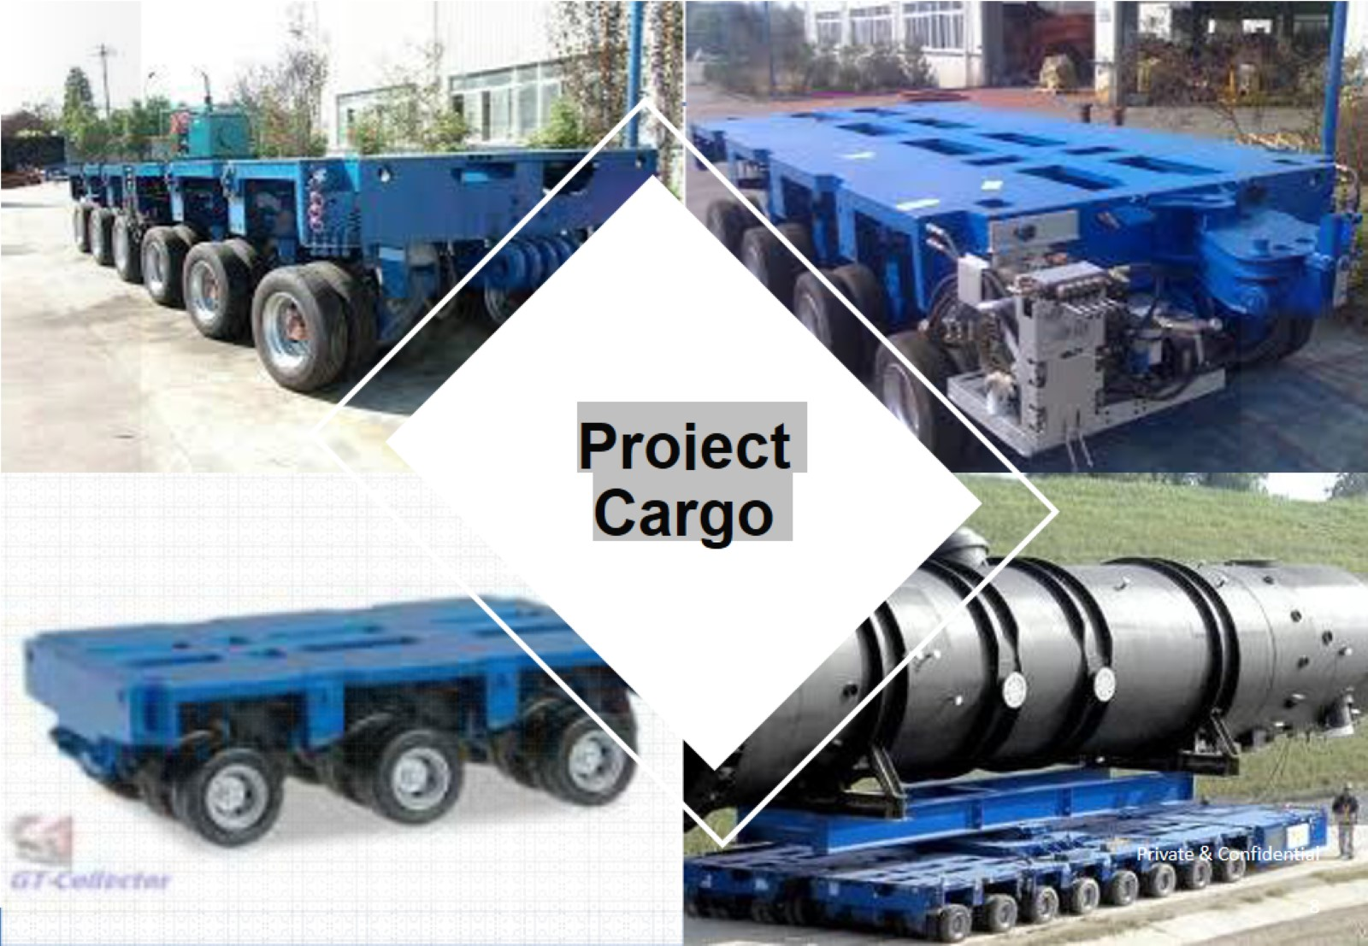

Slide 9
Project Cargo Division

Slide 10
Land Transport – Project Cargo

Slide 11
Our Principal Business Activities

Slide 12
Land Transport – Container Haulage

Slide 13
Land Transport – Container Haulage

Slide 14
Our Principal Business Activities

Slide 15
Warehouse & Distribution Services

Slide 16
Snapshots of Our Warehouses

Slide 17
Our Principal Business Activities

Slide 18
Freight Forwarding & Customs Brokerage

Slide 19
Our Principal Business Activities

Slide 20
Manufacturing, Fabrication & Refurbishment of Trailers

Slide 21
Our Fabrication Capabilities

Slide 22
In-House Maintenance Expertise

Slide 23
Snapshot of Xin Hwa Group as at 31 December 2019

Slide 24
Clientele From Various Industries

Slide 27
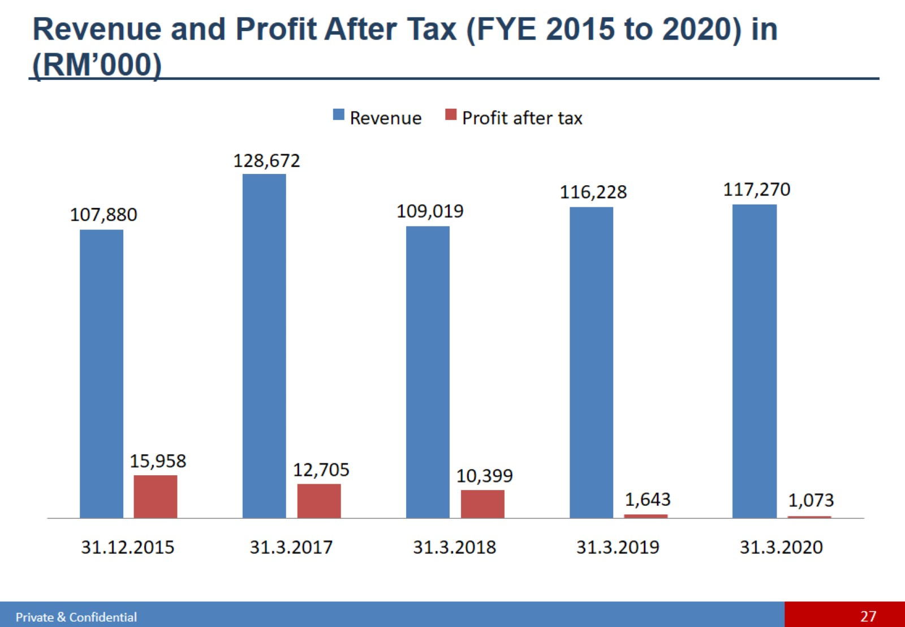
Revenue and Profit After Tax (FYE 2015 to 2020) in
(RM’000)

Slide 32
Growth Plans – Warehouse Expansions

Slide 33
Growth Plans – Warehouse Expansions

Slide 35
Expansion Plans

Slide 36
Growth Plans – Integrated Logistic Hub

Slide 37
Growth Plans – Integrated Logistic Hub

Slide 38
Warehouse Expansions in Summary

Slide 41
Expansion Plans – Expansion into Indonesia

Slide 42
Growth Plans – Expansion into Indonesia

Slide 44
Disclaimer

