Slide 1
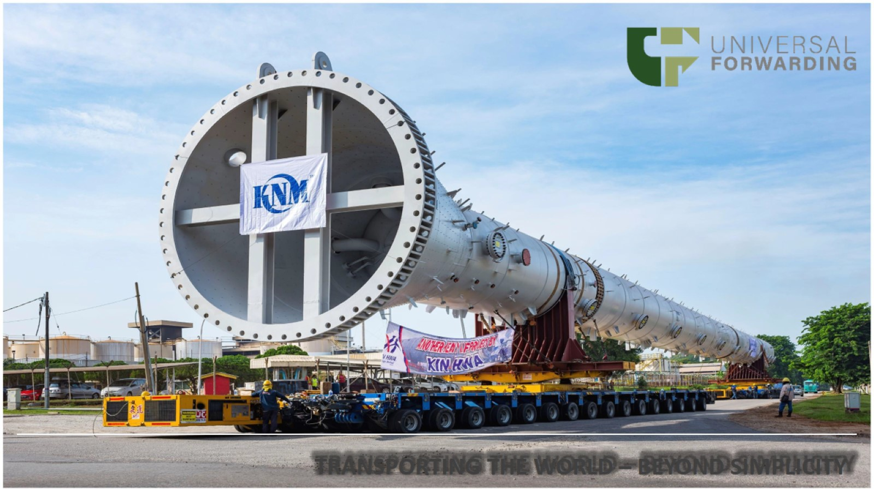

Slide 3
Our Industry Coverage

Slide 6
FCL & LCL Service

Slide 7
WAREHOUSE & DISTRIBUTION

Slide 8
Our Experience

Slide 9
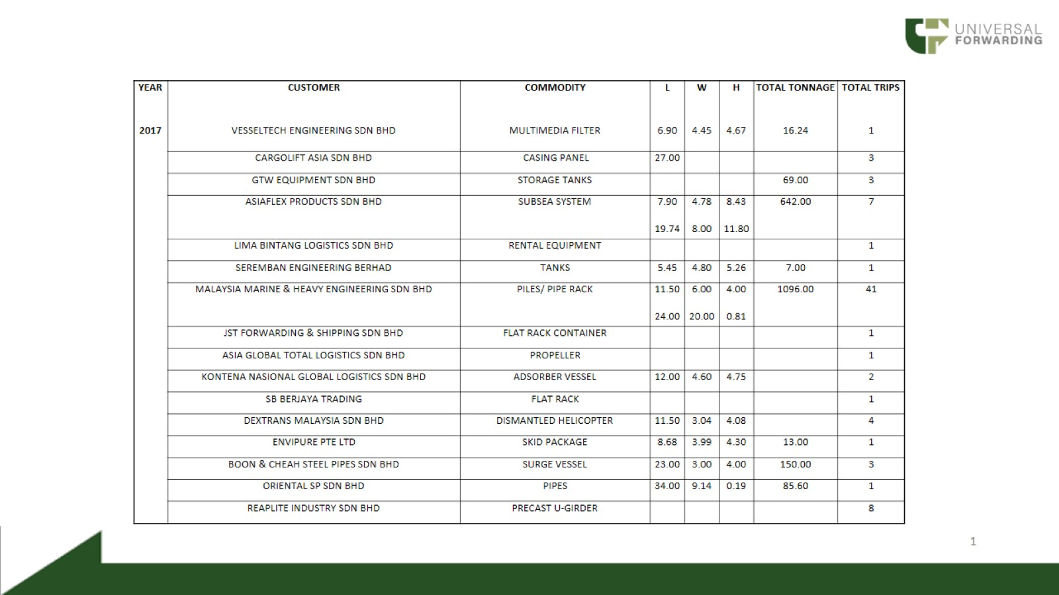

Slide 10
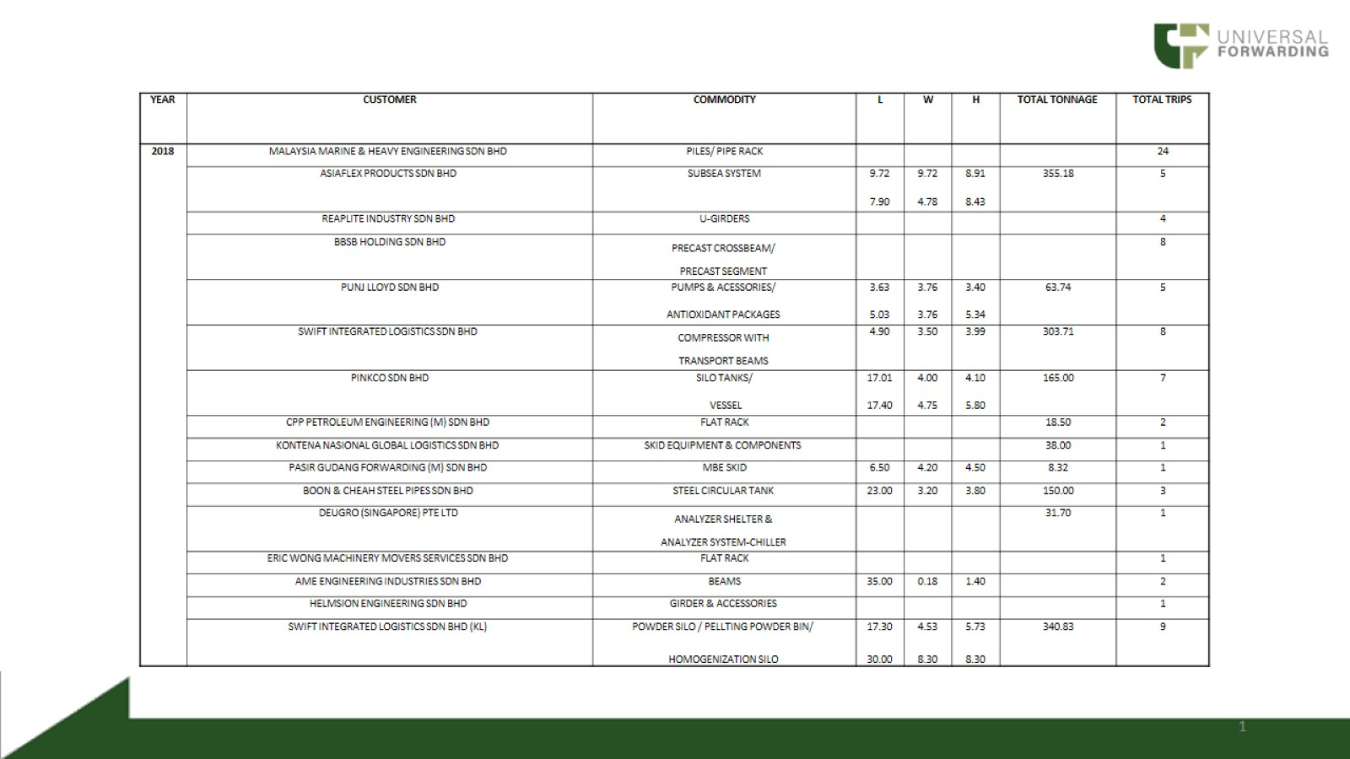

Slide 11
LIST OF TRUCKS/TRAILERS

Slide 12
eTRUCX

Slide 13
CERTIFICATION

Slide 14
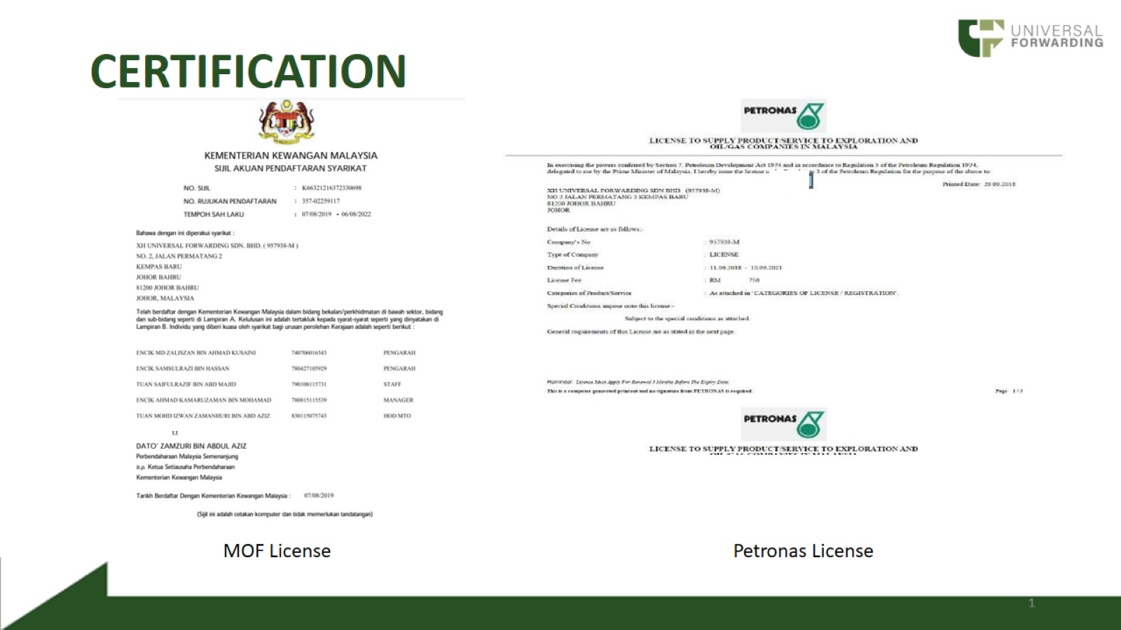
CERTIFICATION

Slide 15
CERTIFICATION

