Slide 1


Slide 2


Slide 3
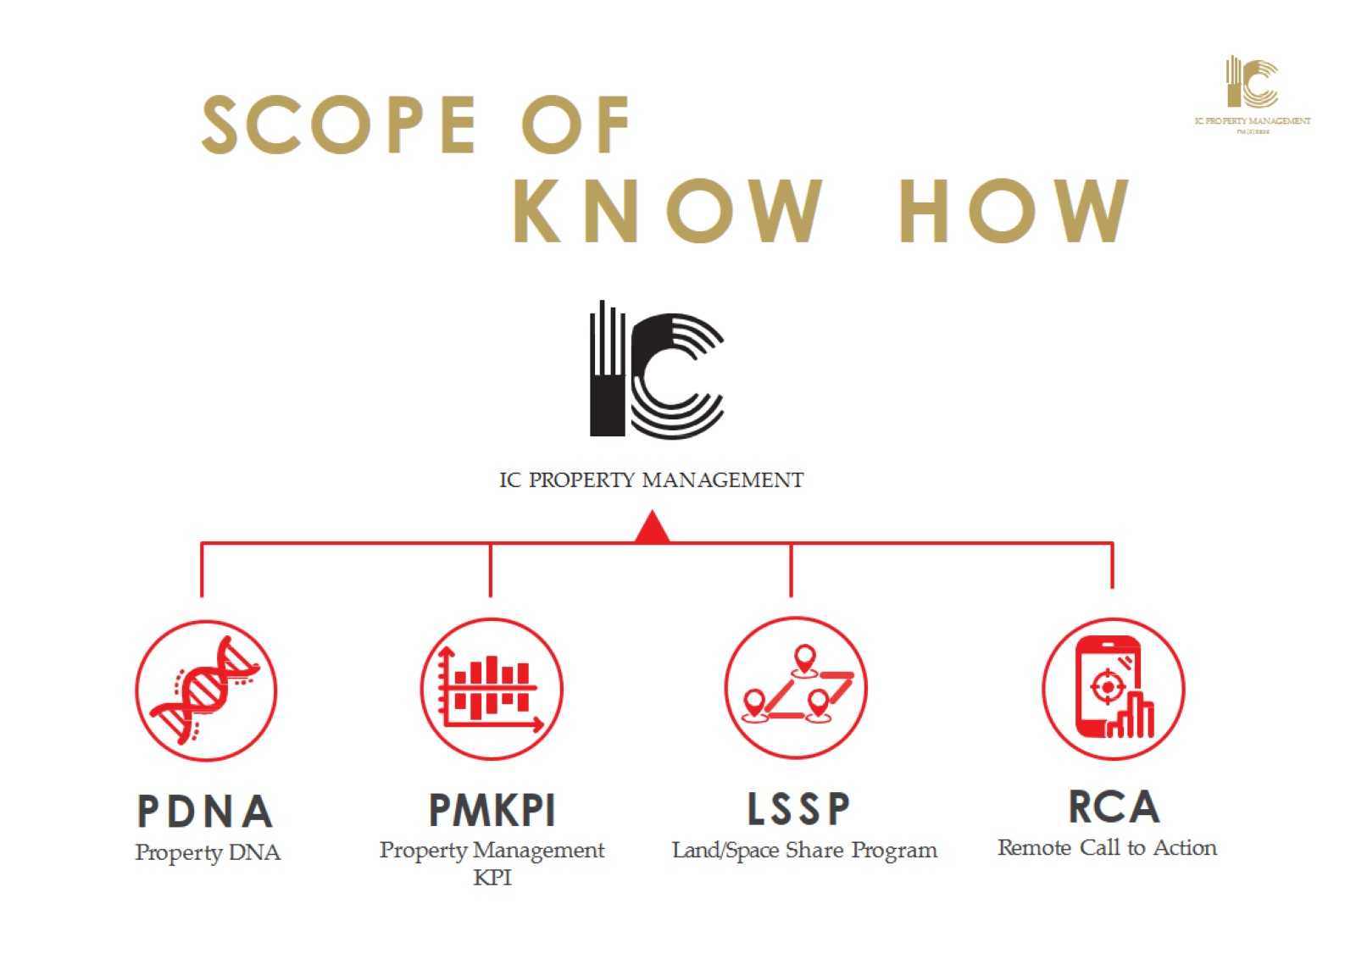

Slide 4
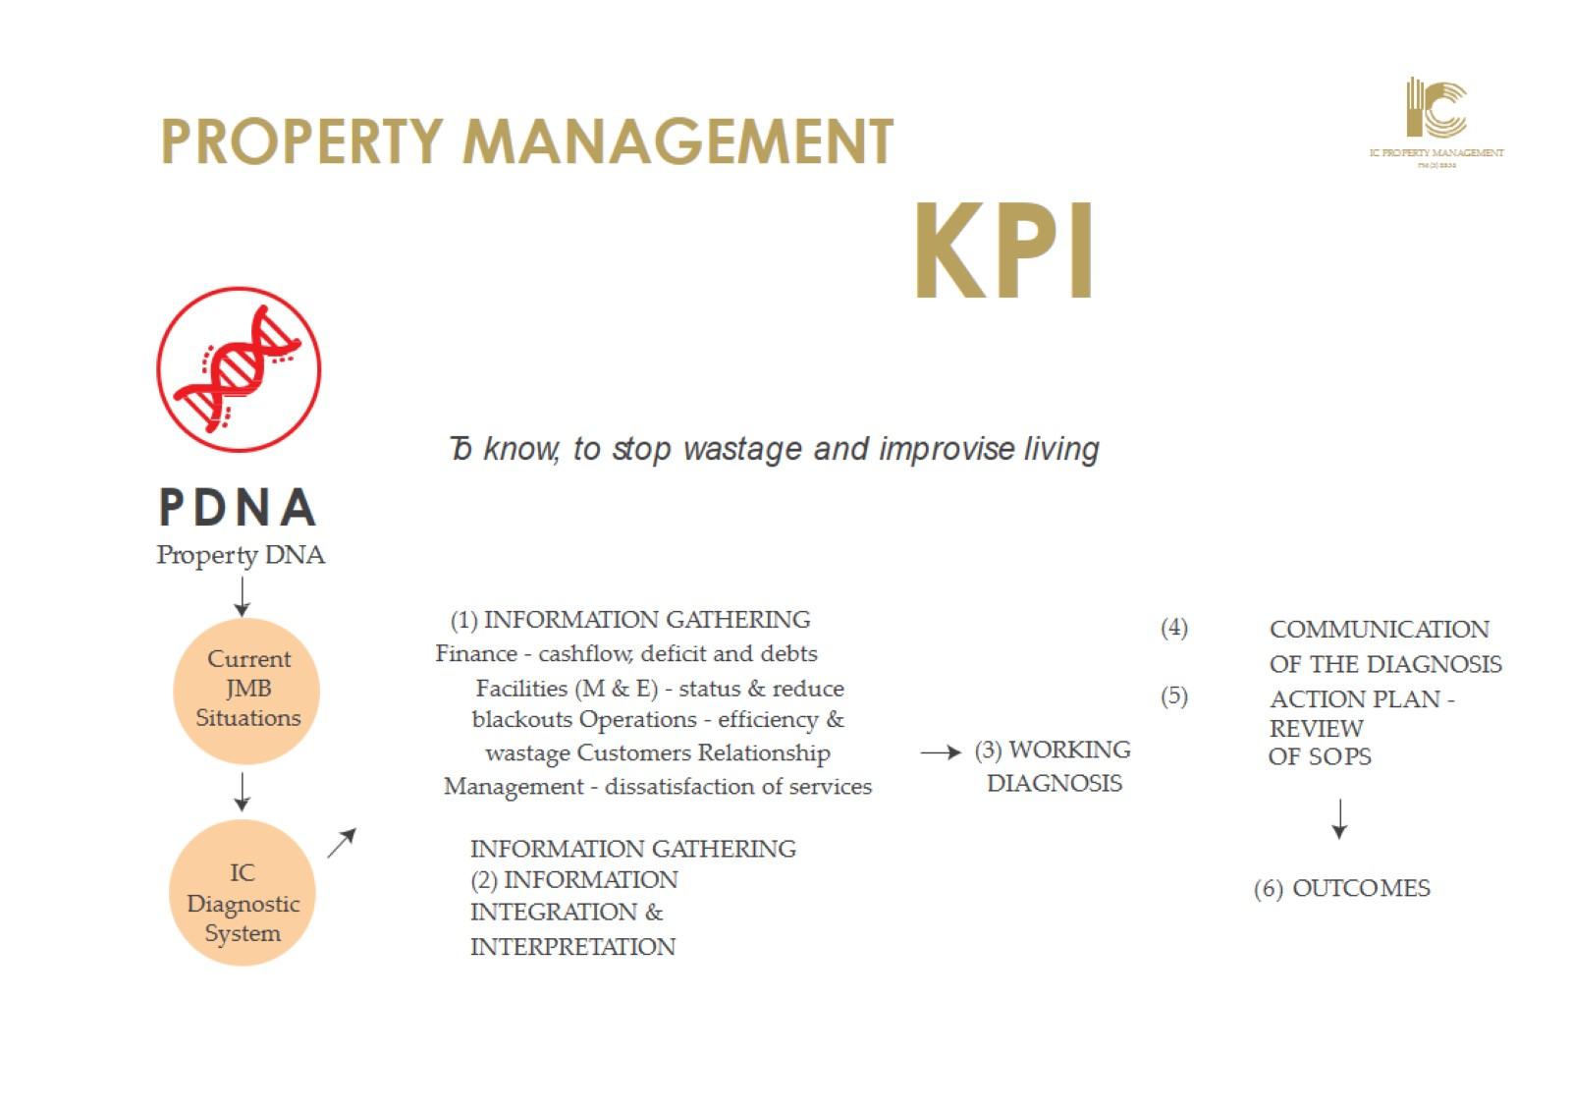

Slide 5
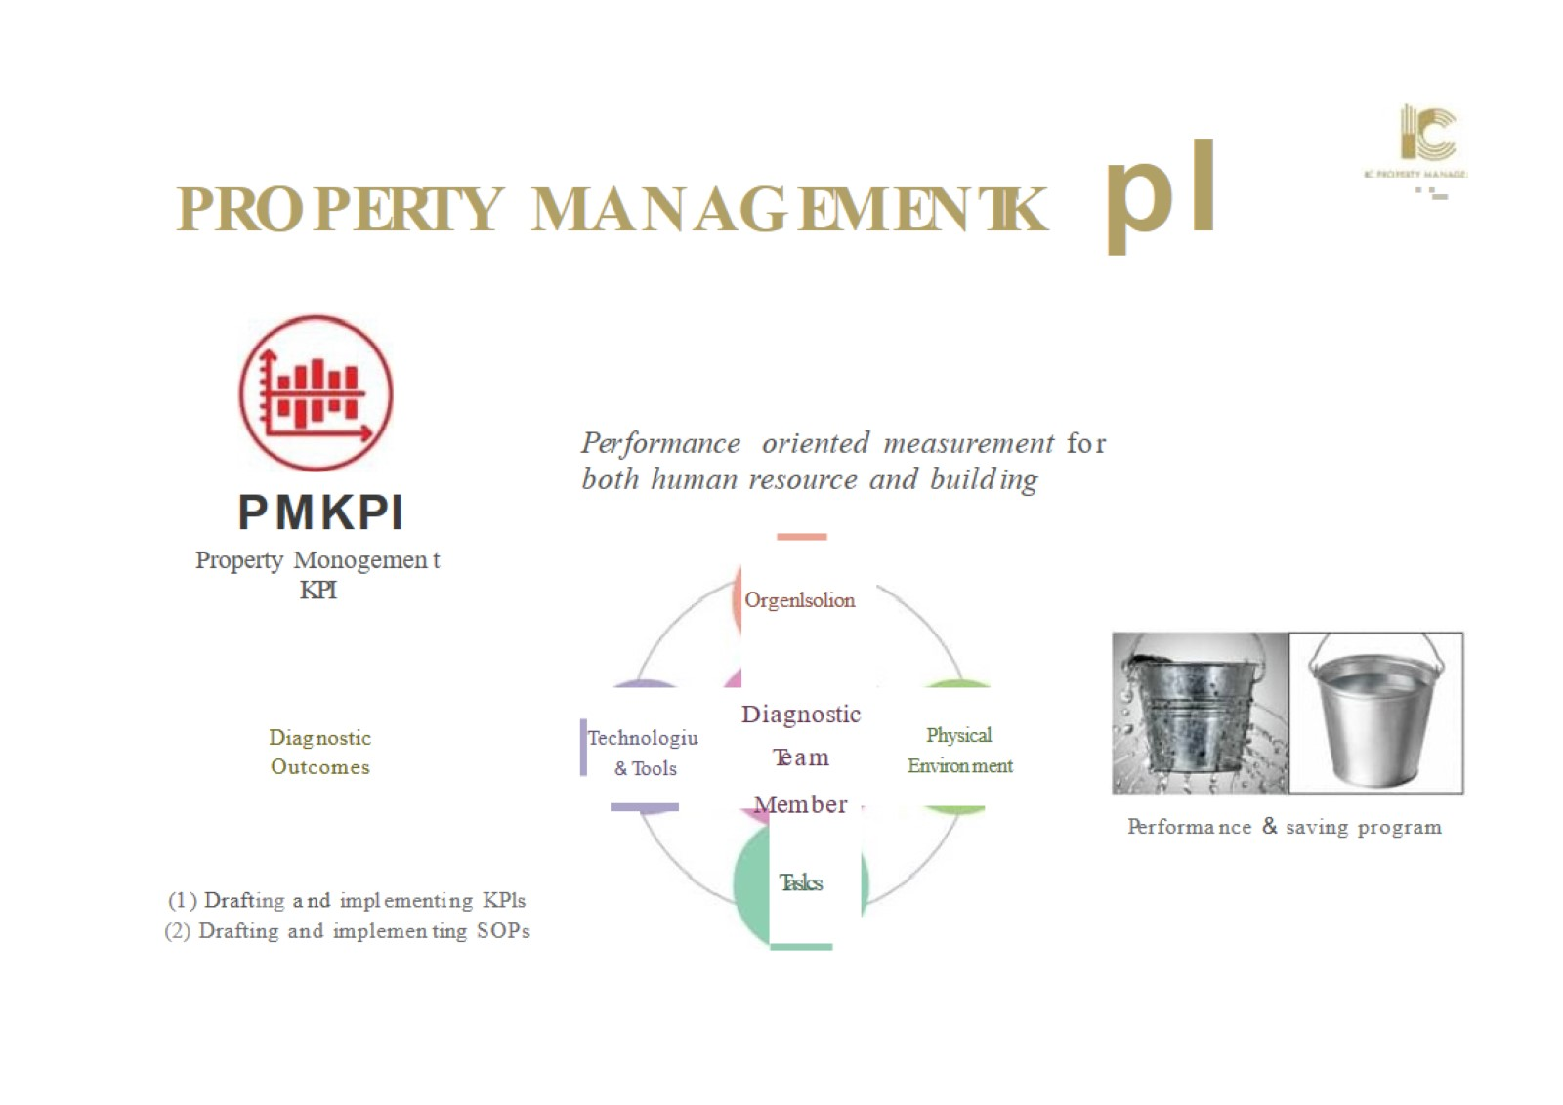

Slide 6

L A N D/ SPACE
S H A R E P R OGRAM

Slide 7


Slide 8

THE TEAM

Slide 9
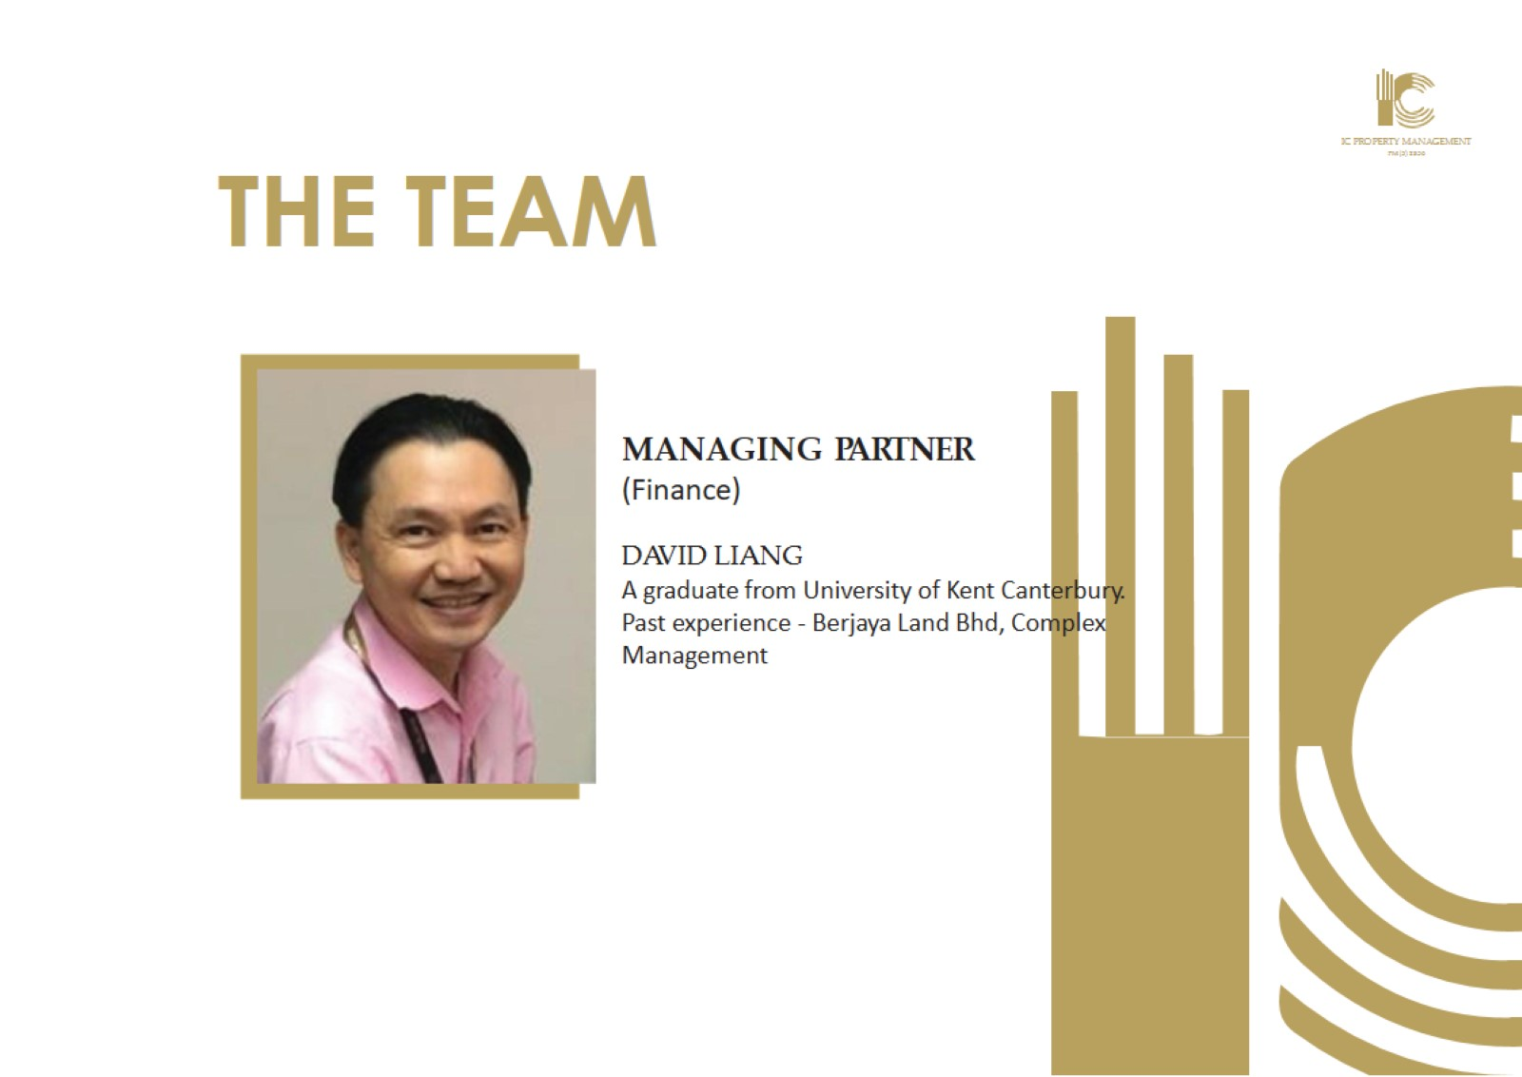
THE TEAM

Slide 10

THE TEAM

Slide 11
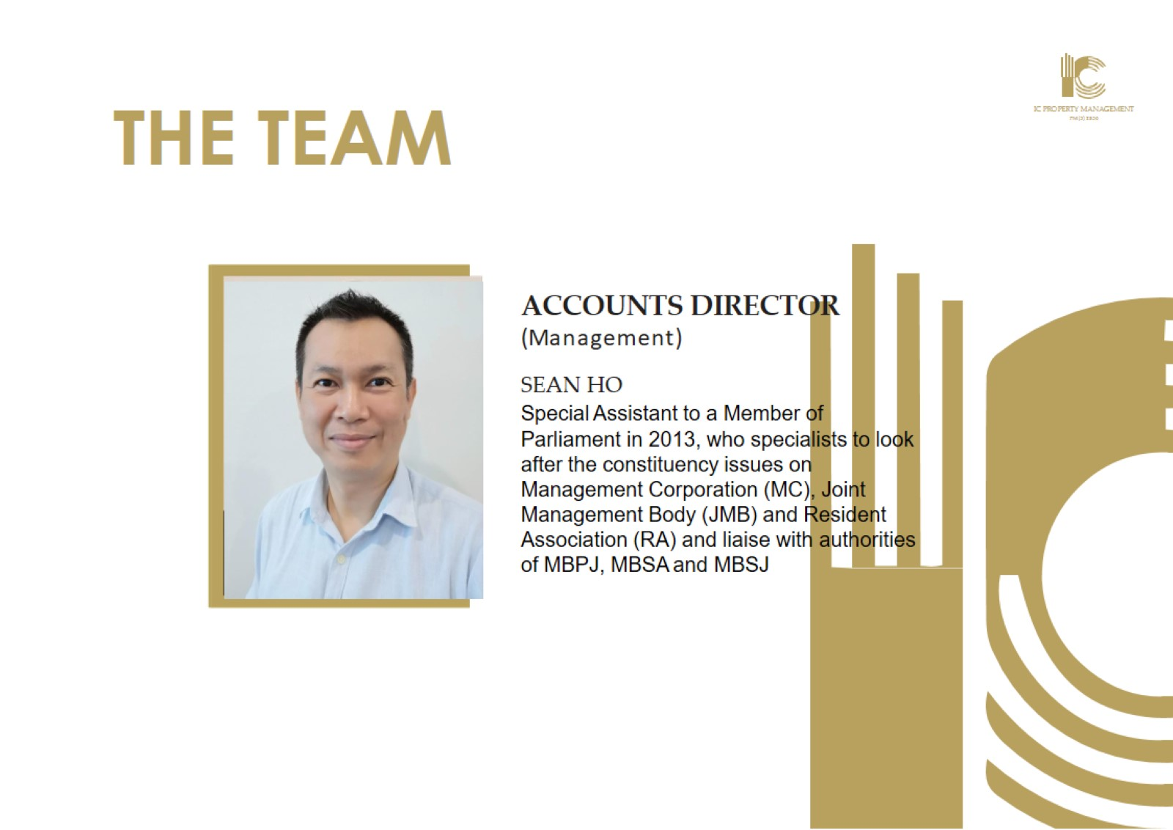
THE TEAM

Slide 12

THE TEAM

Slide 13
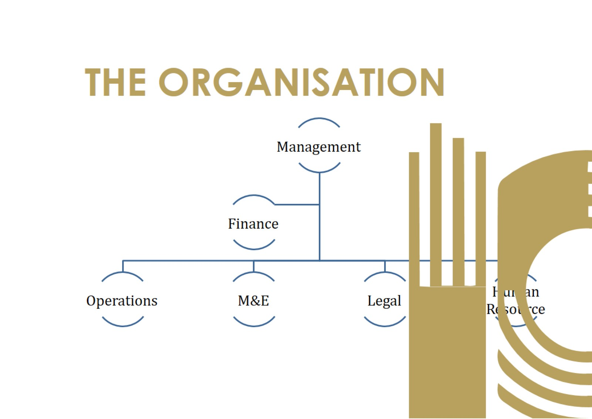
THE ORGANISATION

Slide 14
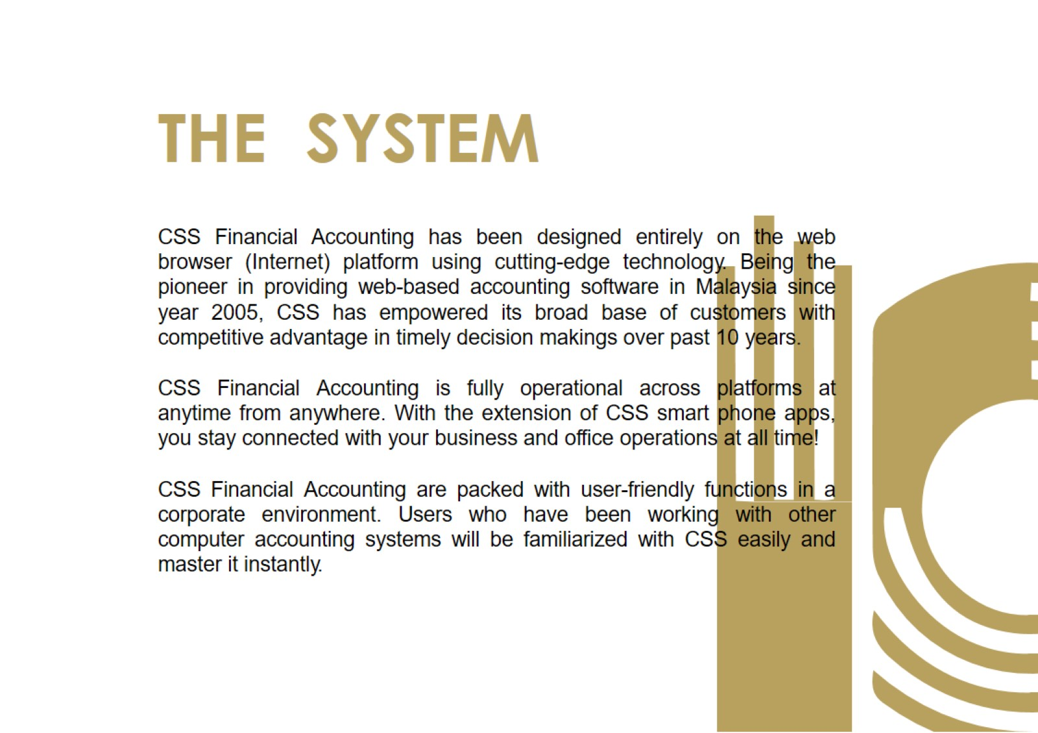

Slide 15
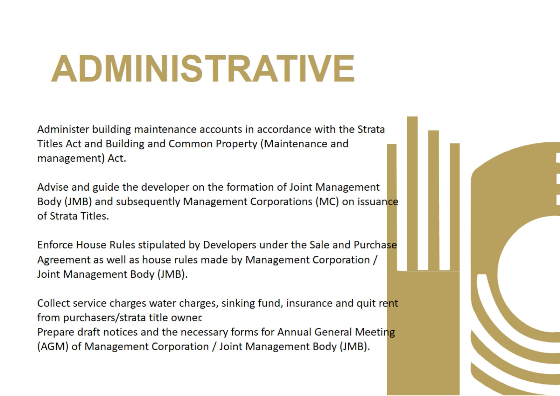
ADMINISTRATIVE

Slide 16
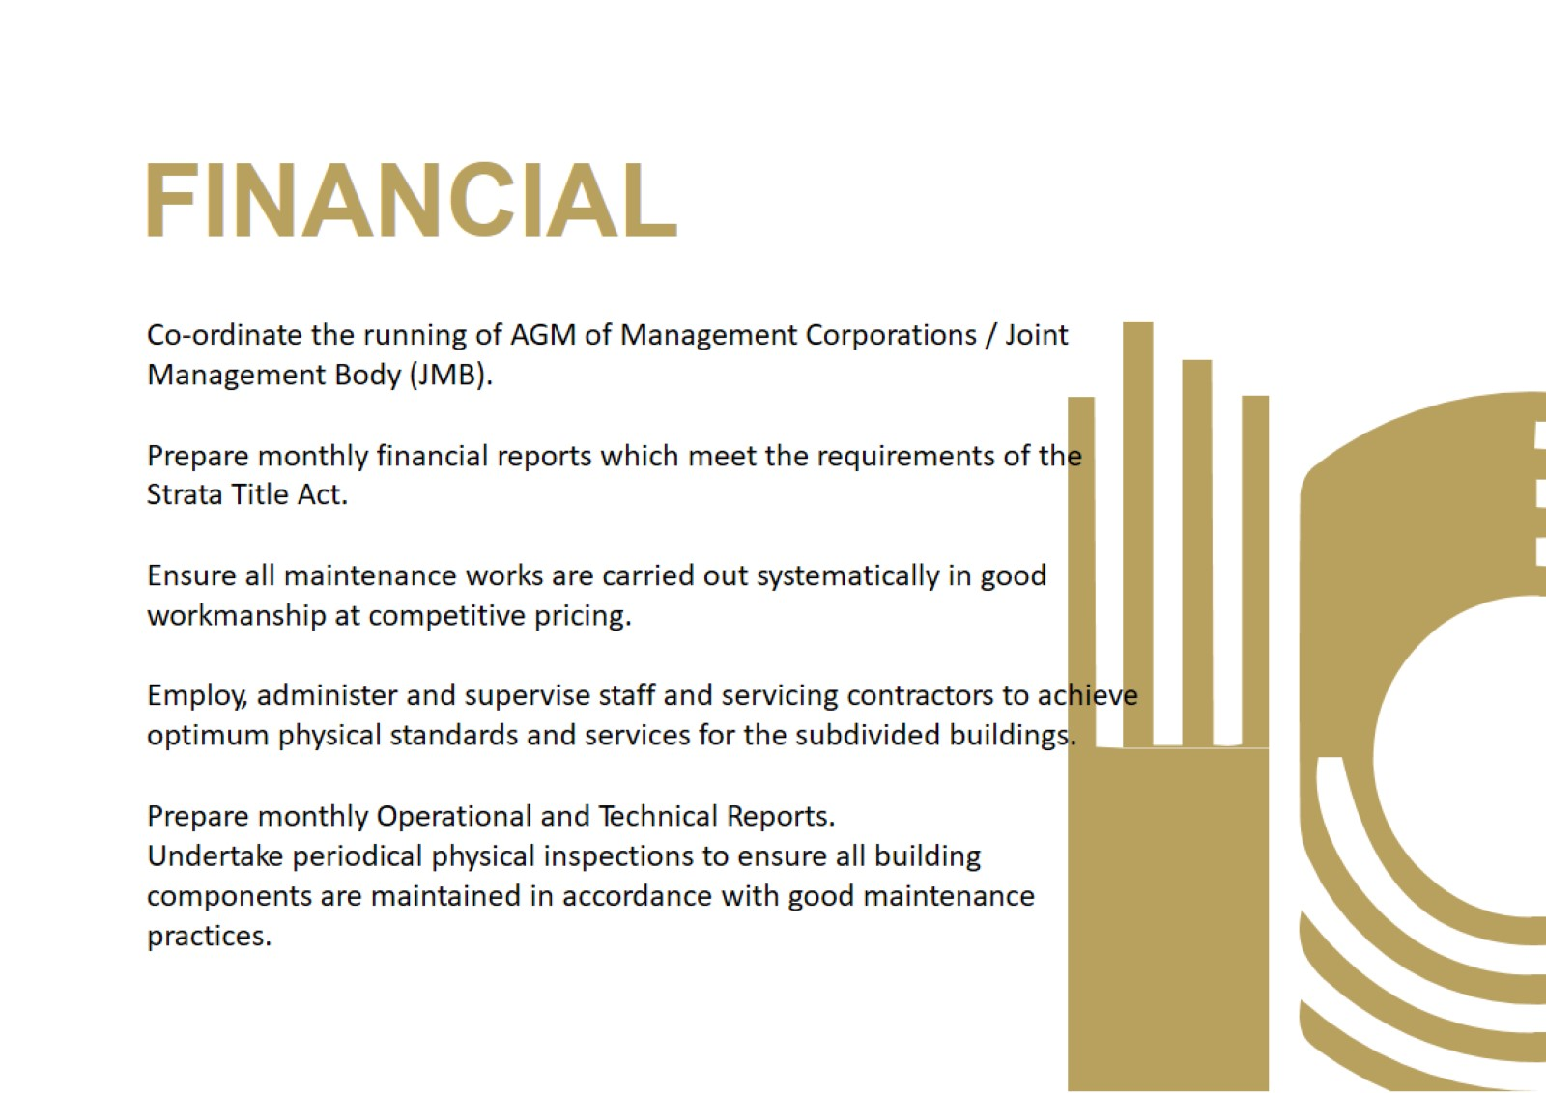
FINANCIAL

Slide 17
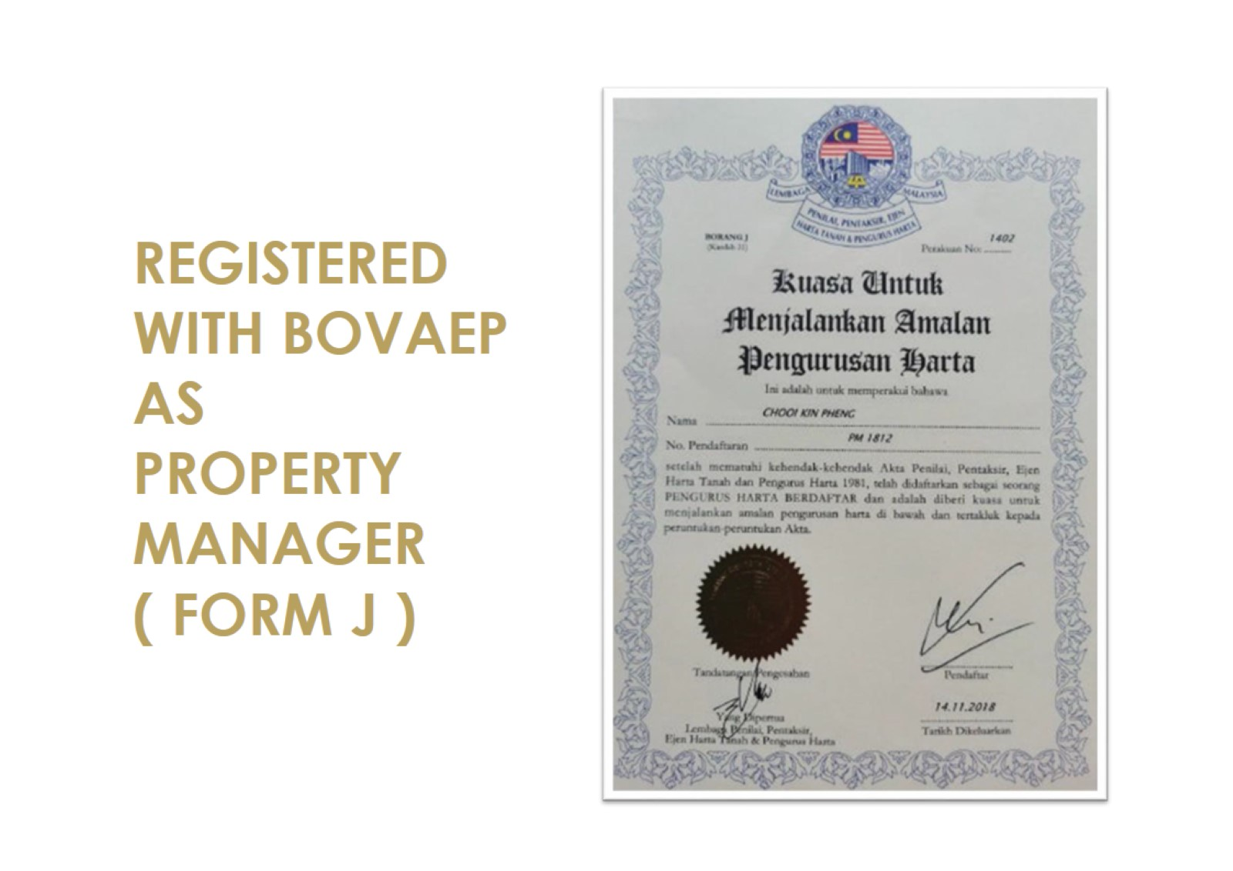

Slide 18


Slide 19


Slide 20


Slide 21


Slide 22


Slide 23


Slide 24


Slide 25


Slide 26
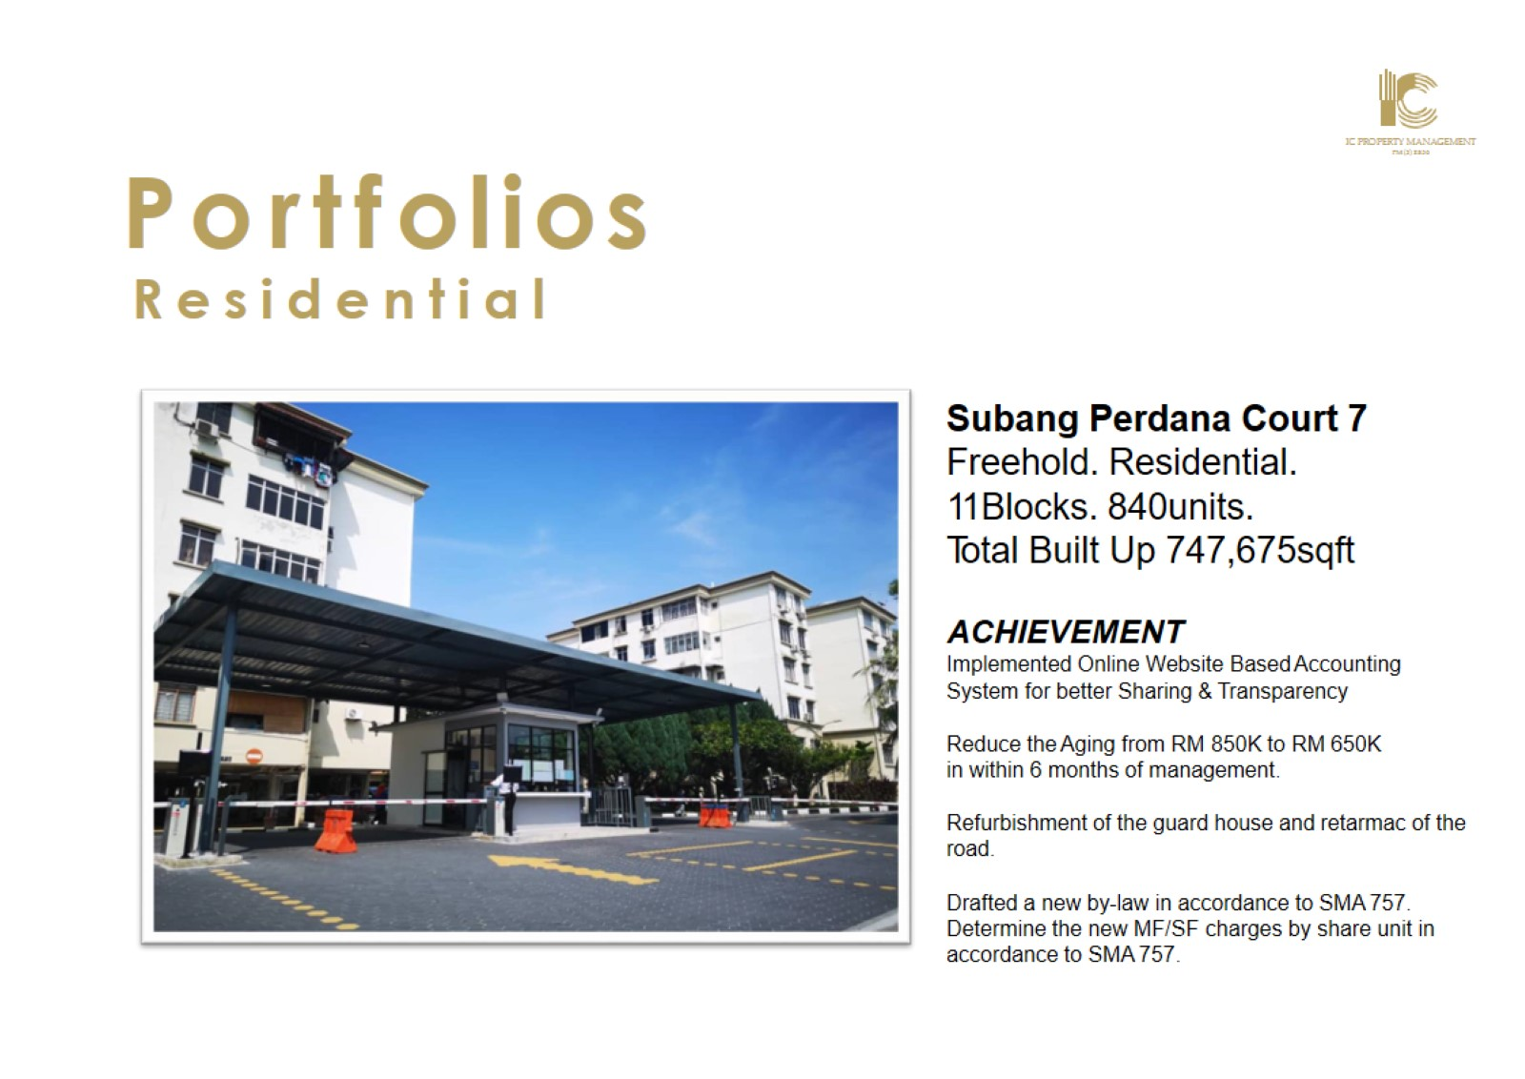

Slide 27
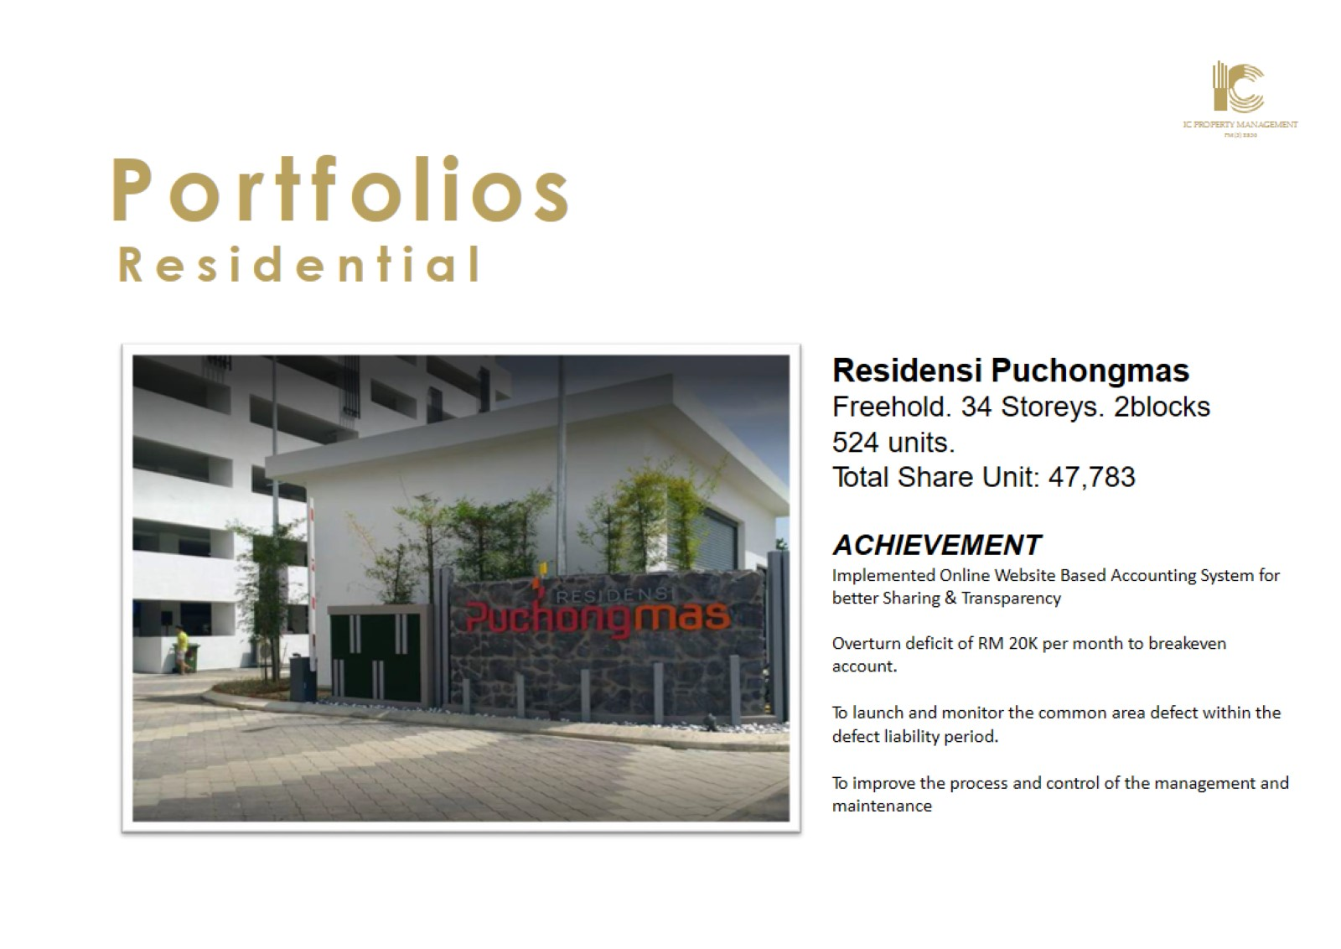

Slide 28
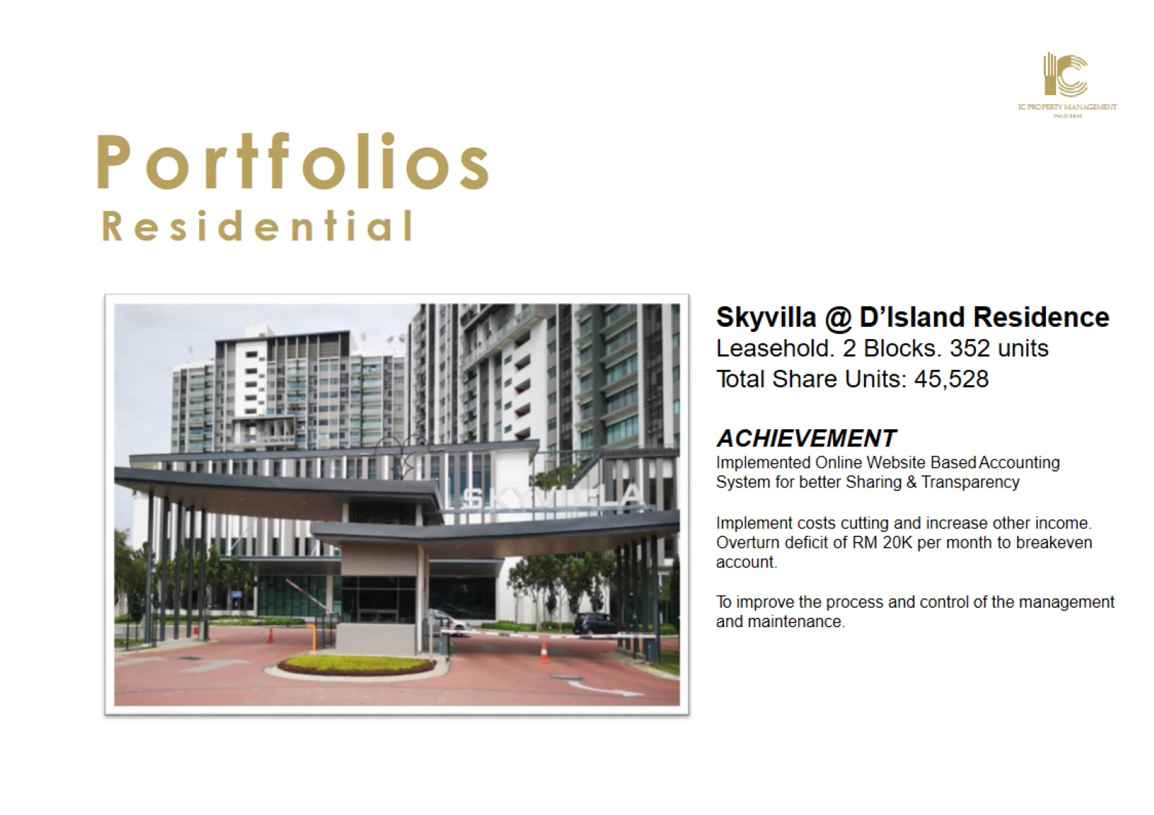

Slide 29


Slide 30


Slide 31
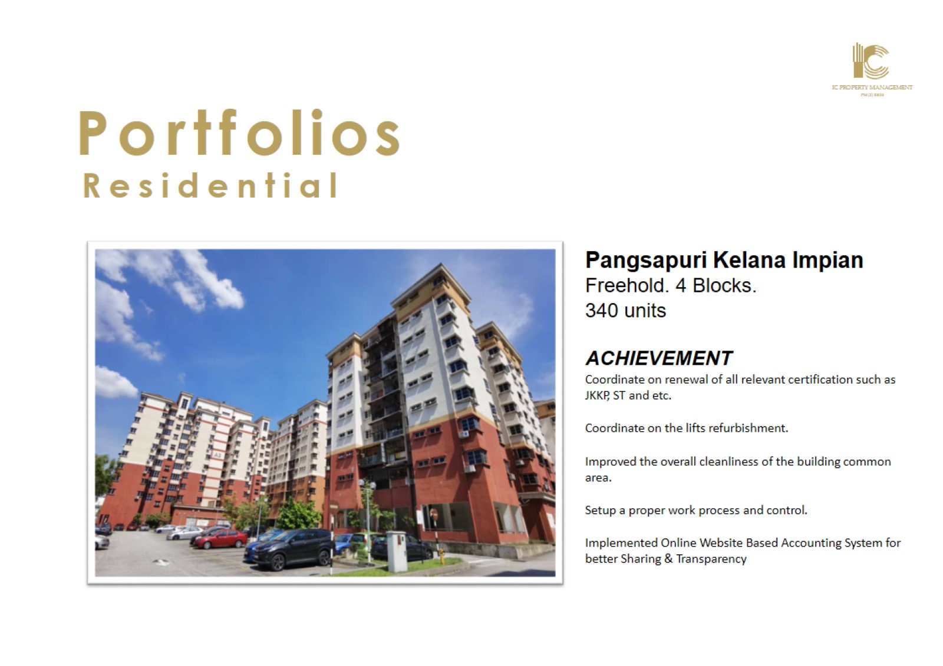

Slide 32


