Slide 1
COMPANY PROFILE

Slide 2
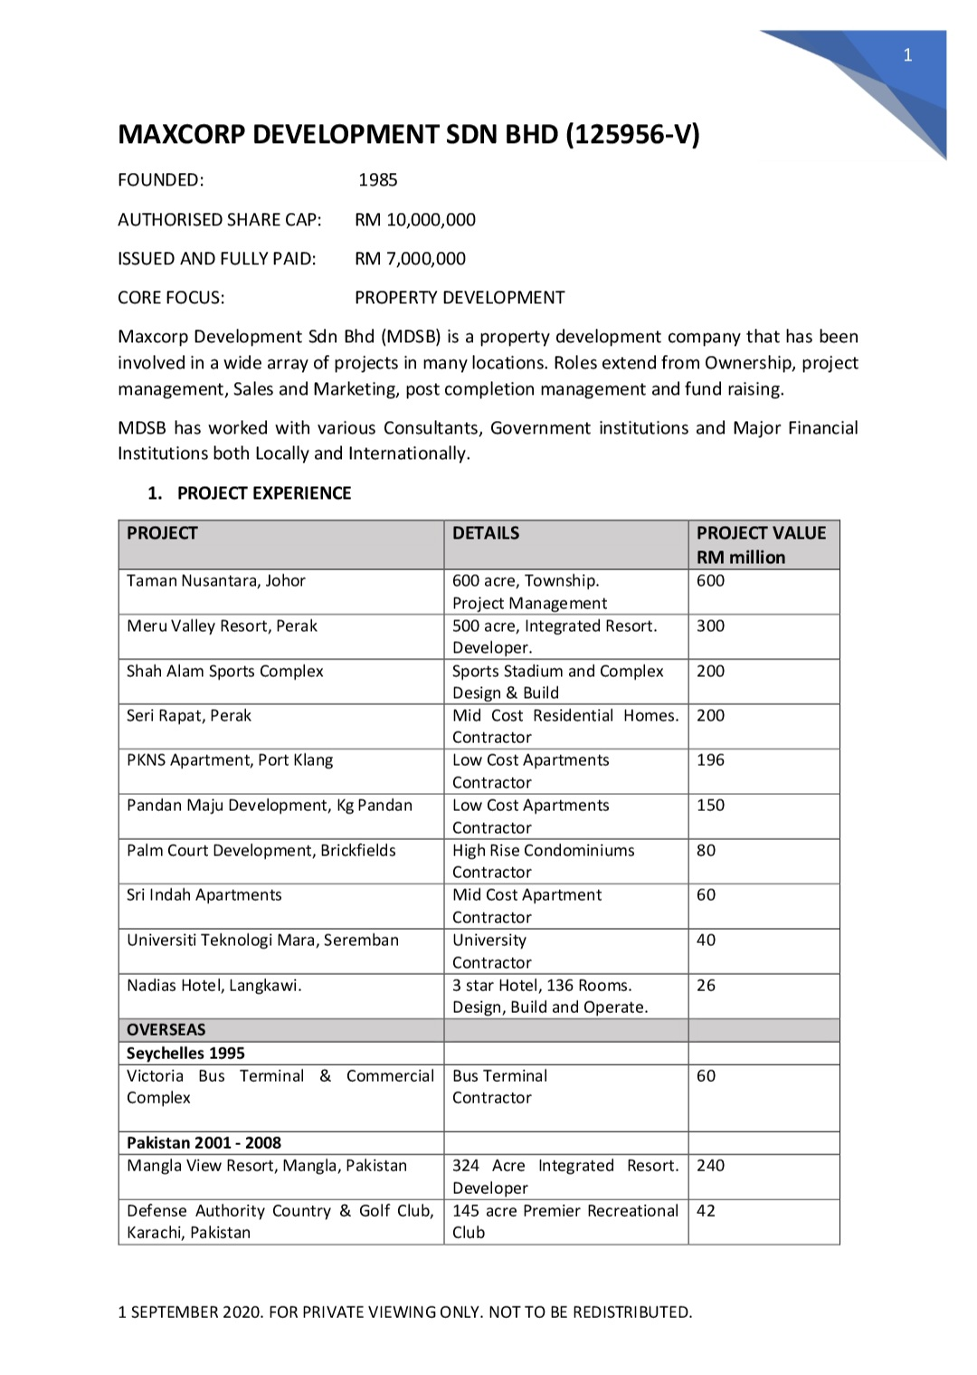

Slide 3
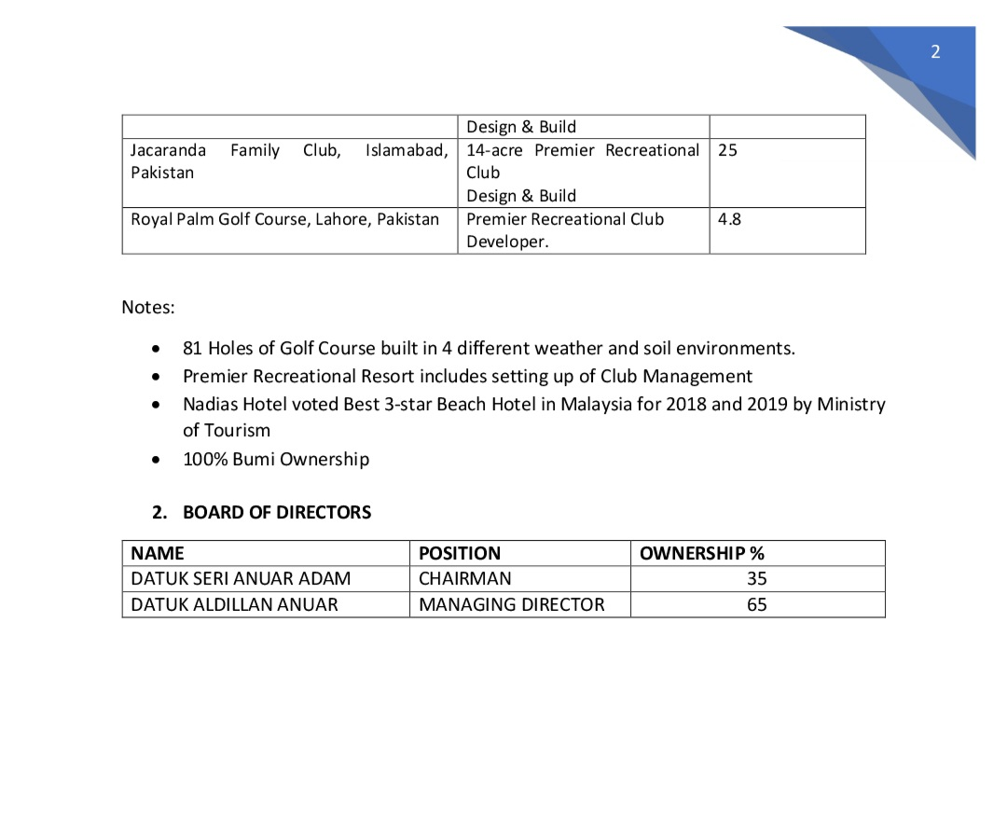

Slide 4
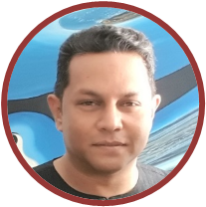
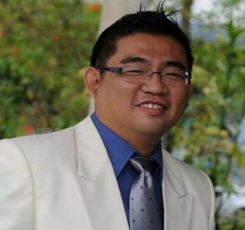
TEAM MEMBERS
Datuk Aldillan Anuar
Director,
Foddercube Sdn Bhd
Izan Johan
Director,
Foddercube Sdn Bhd
Andrew Tan
Chief Financial Officer,
Foddercube Sdn Bhd

Slide 5
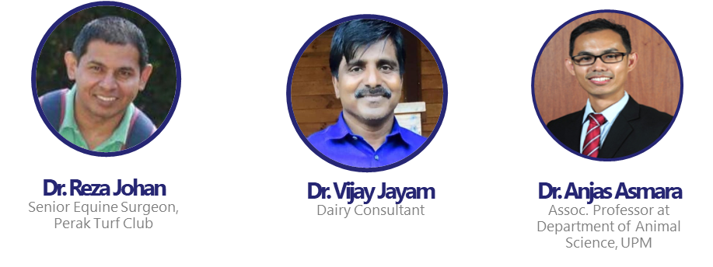
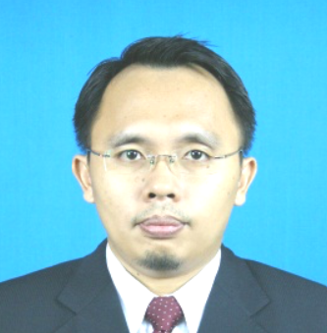
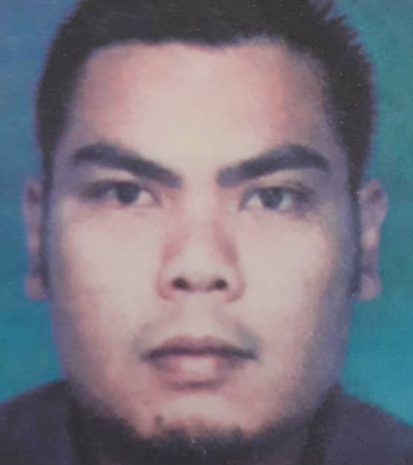
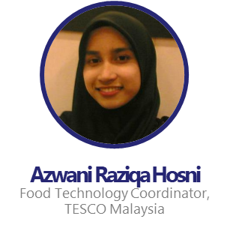
TEAM MEMBERS
Halil Mohamad Alip
Former Senior Executive,
Agriculture Division, ECERDC
Anas Nasaruddin
Former CEO of MARDI Holdings
Mohd Shahril Yusof
Legal Advisor,
Foddercube Sdn Bhd

Slide 6
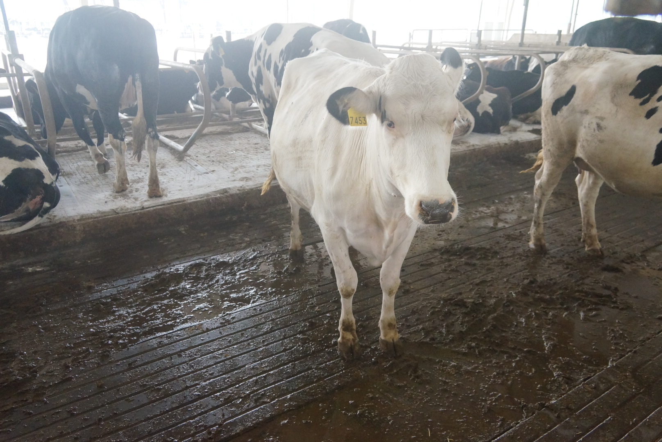
Establishment: 2018
Paid up Capital RM 1,000,000.00
2 Shareholders
DATUK ALDILLAN ANUAR -DIRECTOR
EN IZAN JOHAN – MANAGING DIRECTOR/ FOUNDER
Mailing Address:
A-10-01
No 3 Plaza Taragon Kelana
47301 Petaling Jaya, Selangor
Malaysia
Tel : +603 78863878
Phone : +6012 6969010
Email : izanfoddercube@gmail.com
Business: Agriculture specialist

Slide 9
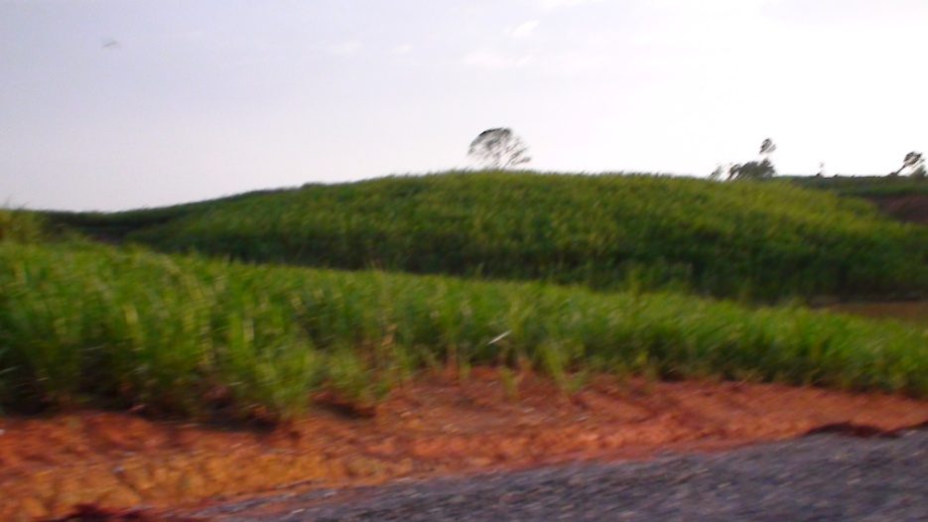
CURRENT / ESTABLISHED PROJECTS
MBPJ, Padang Utara Kompleks sukan Astaka, Petaling Jaya.
2. NJ Farms, Lot 1457, Jalan Kg Sungai Sop, Pekan Bt. 14, HuluLangat, 43100 Selangor Darul Ehsan
- Production of live goats for breeders and slaughter animals
- Total Population- 410 Head
- Current production- 130 heads slaughter animals, per month
- 20 heads breeder animals, per month
Breeder goats are sold to individuals, government agencies, etc
3. FODDER & PASTURE DEVELOPMENT AND ESTABLISHMENT
- Goat breeding and innovation centre, Kuala Behrang, Terengganu
22 Hectars of grass planting
Sub contractors
Client- ECERDC
4. FODDER & PASTURE DEVELOPMENT AND ESTABLISHMENT, Muadzam Shah
Proposed construction and completion of package 2 (fodder and pasture) of Muadzam shah cattle research and innovation center, Pahang Darul Makmur
Sub contractor
Client- ECERDC
5. GRASS HARVESTING
- Muadzam Shah Cattle Reseach Center
Client- FELDA

Slide 10
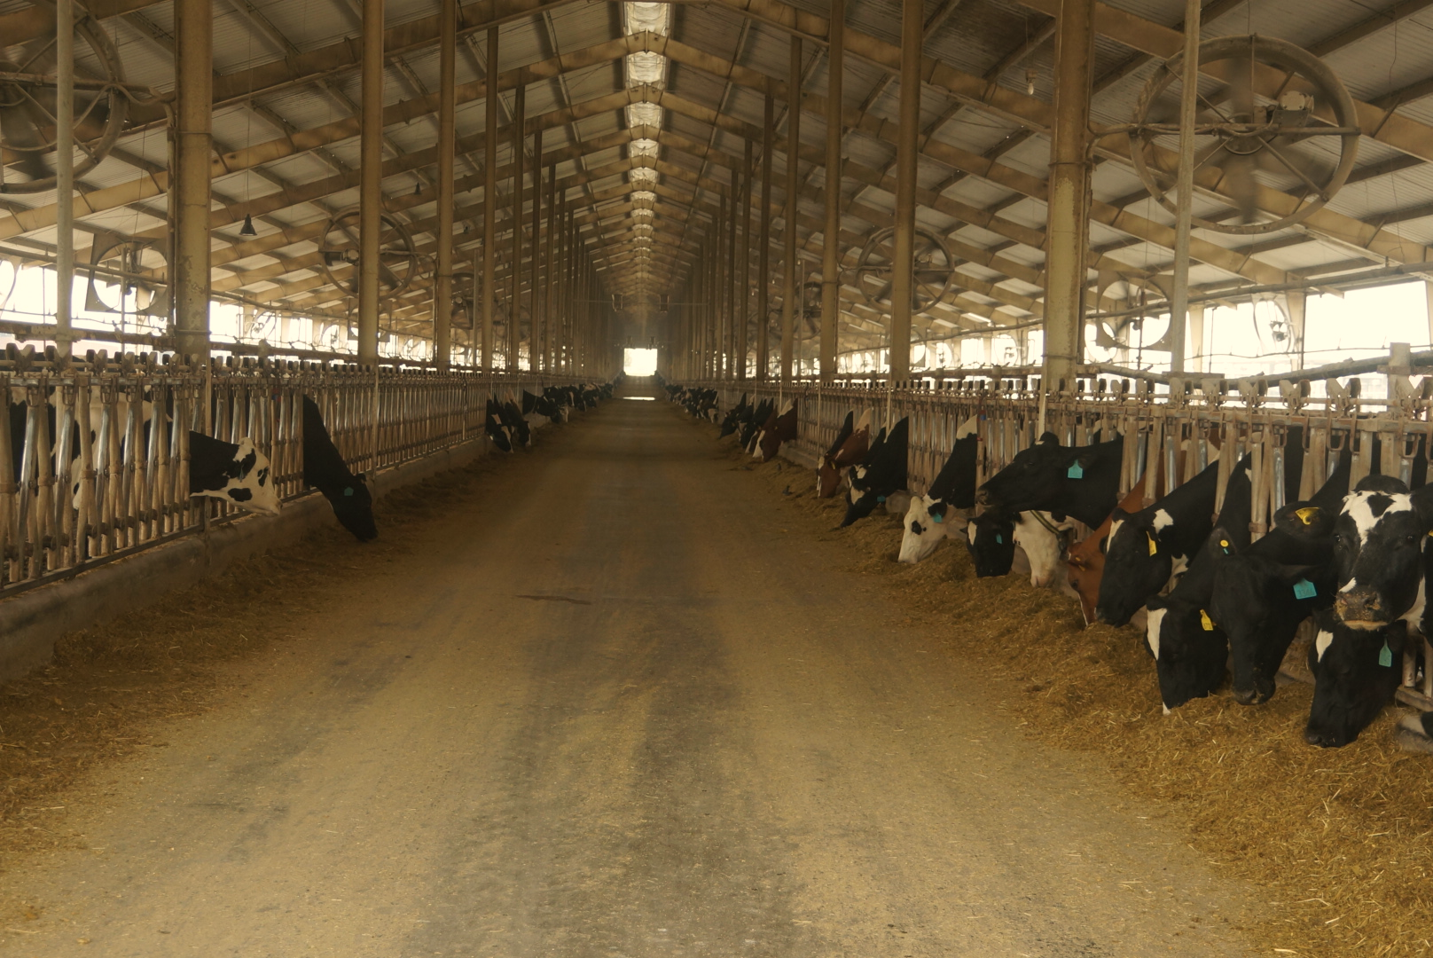
ESTABLISHED PROJECTS
Fakulti Peladangan Universiti Putra Malaysia
Proprietor: UPM
Contact no: Rostam Harun 012 3209437
Type: Pasture establishment napier & braccaria decumbence
45 acres
Dato Dr Aziz Yahya- Bt 21, Sungai Lui, Hulu Langat, Selangor
Proprietor: Dato Dr Aziz Yahya
Contact no: 012 3236252
Type: Design, built and supply infrastructure for goat breeding, 150 head of
breeder females and 20 male goats.
Dato Seri Abang Abu Bakar Abg Kamaruddin- Lot 440, Jalan Rumah Rakyat, Teluk Kemang, Port Dickson
Proprietor: Dato Seri Abang Abu Bakar Abg Kamaruddin
Contact no: 012 2777651
Type: Design, built and supply infrastructure for goat breeding, 50 head of
breeder females and 2 male goats.

Slide 11
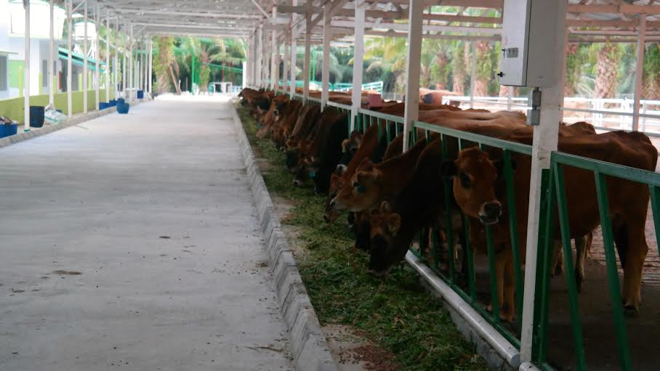
ESTABLISHED PROJECTS
GT Farm: Lot 447, Jalan Sg Lui, Bt. 21, Pekan Hulu Langat, Selangor
Proprietor: En Nik Razali Jusoh
Contact no: 012 2842169
Type: Design, built and supply infrastructure for goat breeding, 150 head of
breeder females and 10 male goats.
MN Farms: Lot 7004, Jln Kg. Jawa Sg. Lui, Pekan Bt. 18, Hulu Langat, Selangor
Proprietor: Tuan Hj Muhijo Madin
Contact no: 019 3399252
Type: Design, built and supply infrastructure for goat breeding, 100 head of
breeder females and 10 male goats.
Green Acres Sdn Bhd: Salak Tinggi Salak, Selangor
Proprietor: Yasmin Agrotech Sdn Bhd (Rashid Ghani)
Contact no: 012 2980212
Type: Design, built and supply infrastructure for goat breeding, 250 head of
breeder females and 20 male goats.

Slide 12
Grass planting
FIRST PLOUGH
FIRST PLOUGH
FIRST PLOUGH
PLANTING ROWS

Slide 13
Grass planting

Slide 14
Grass planting

Slide 15
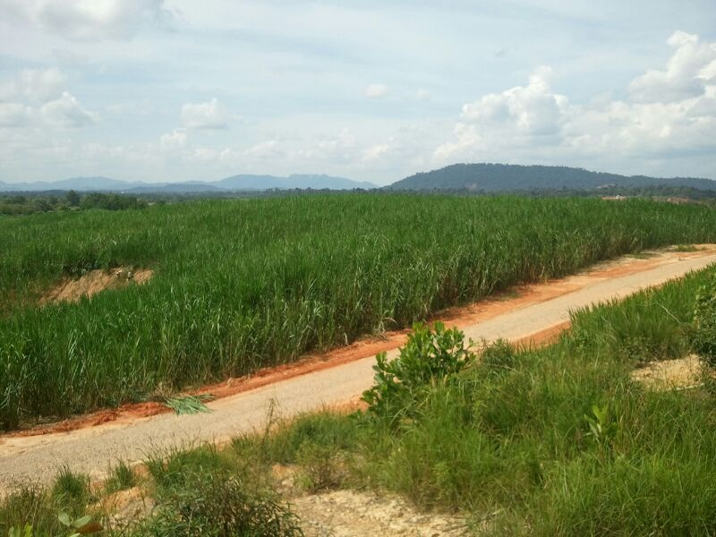
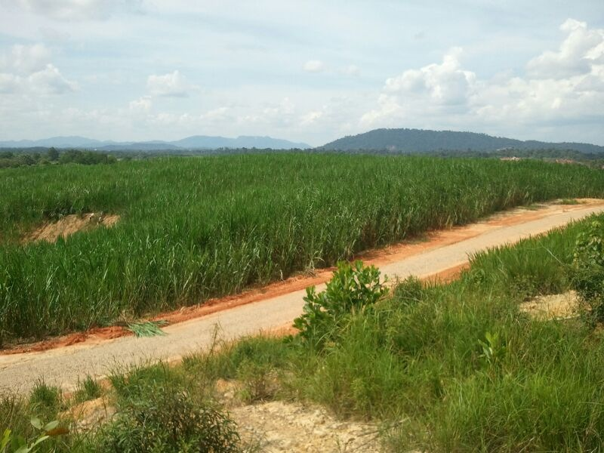
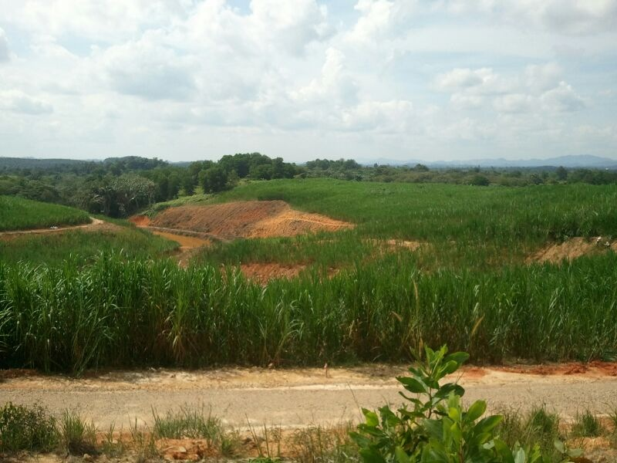
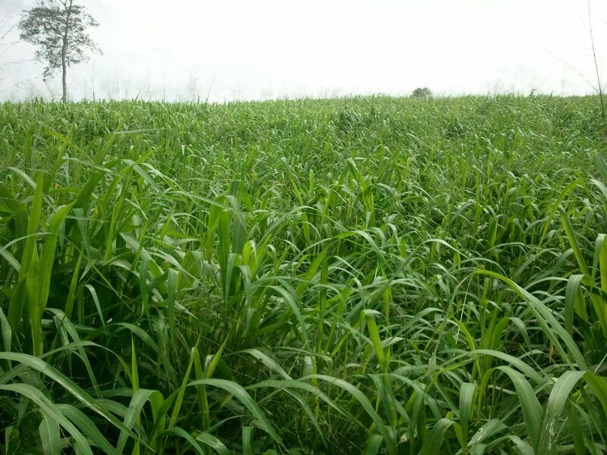
Grass planting

Slide 16
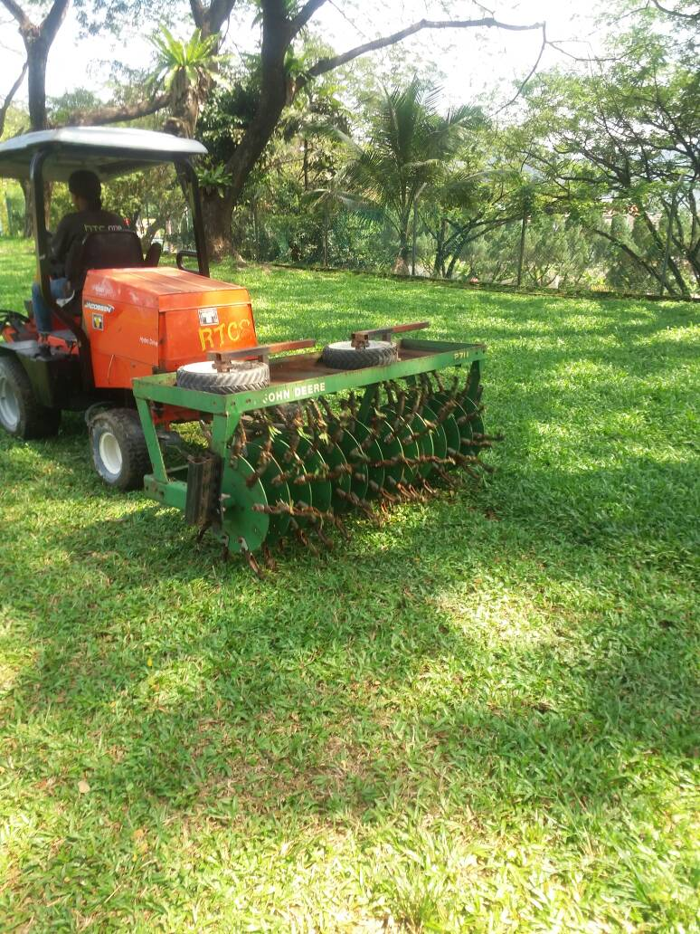
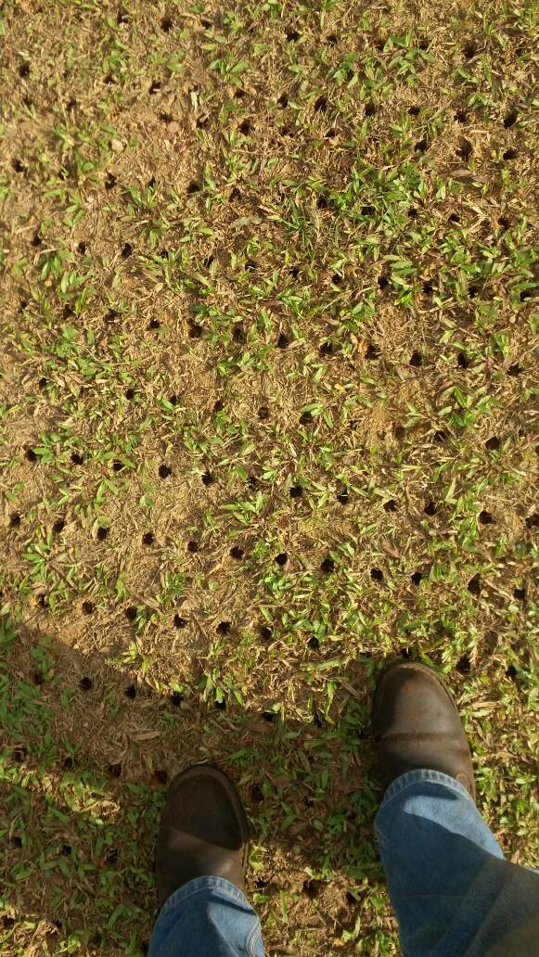
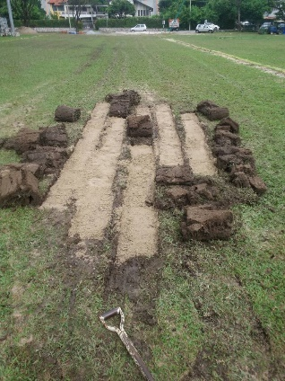
Field Maintenance

Slide 17
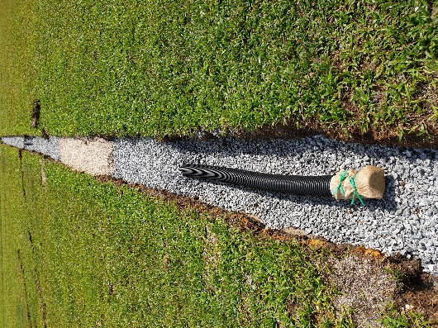
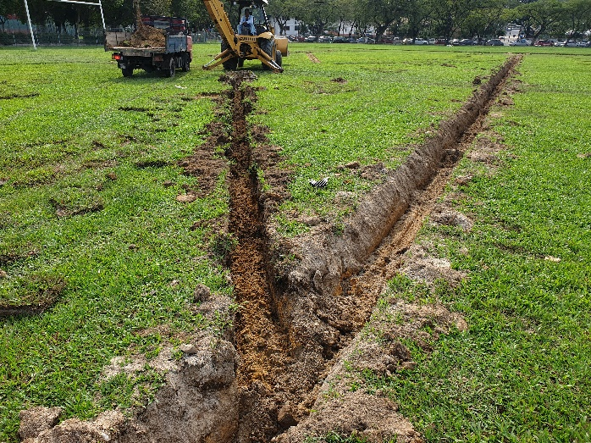
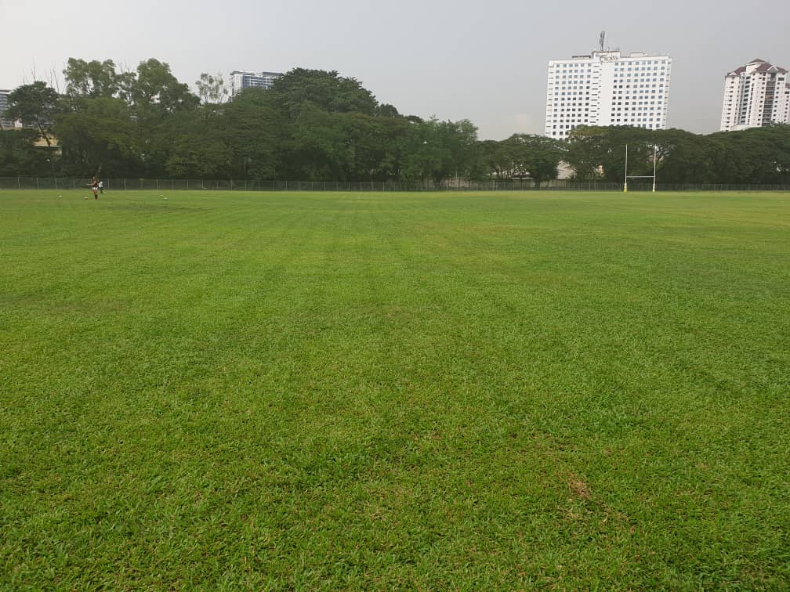
Field Maintenance

Slide 18
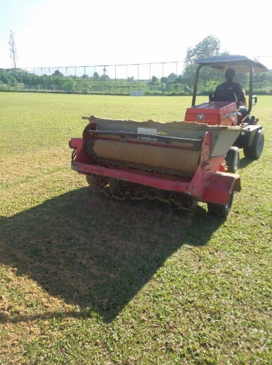
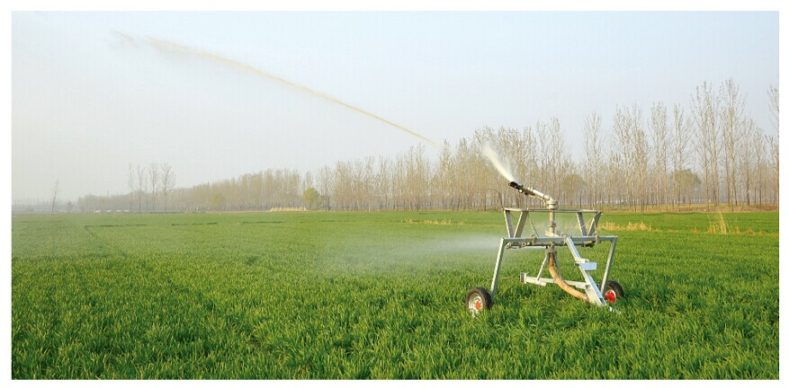
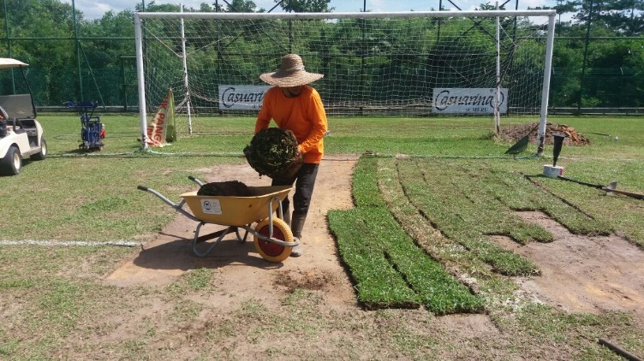
Field Maintenance

Slide 19
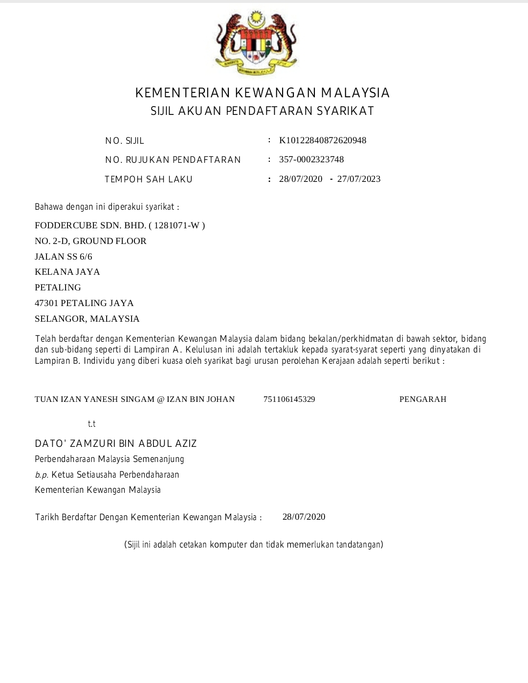

Slide 20
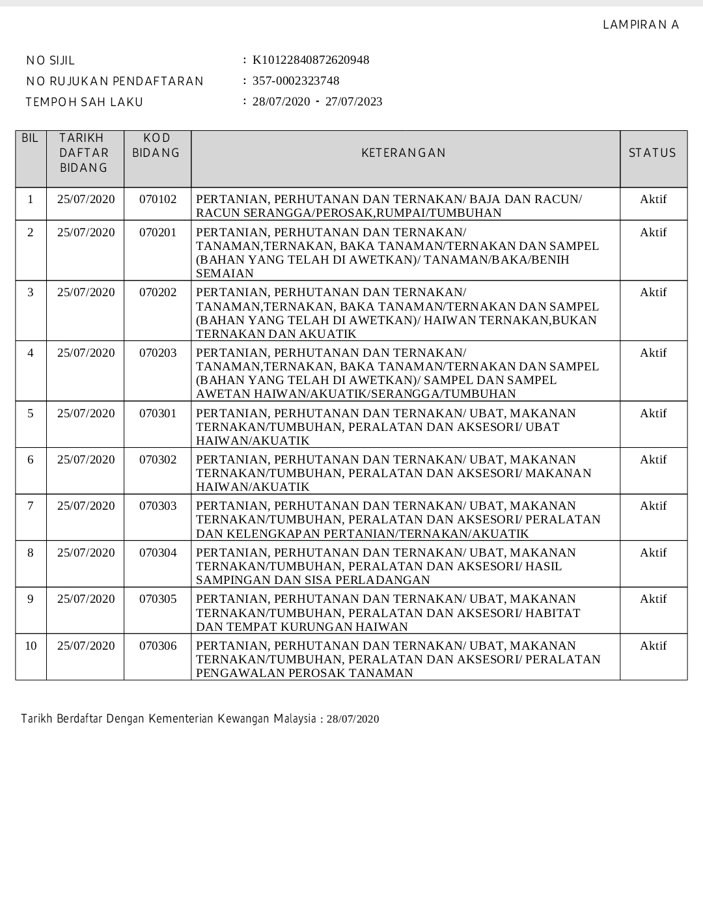

Slide 21
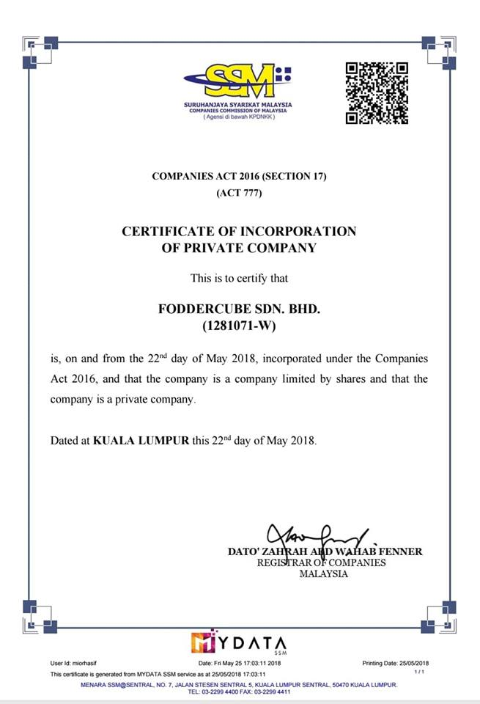

Slide 22
